Slide 1

School of Technology, Design and Computer Application Silver Oak College of Compter Application
Department of Computer Application
A PROJECT PRESENTATION ON
E-Learning
Submitted By
Rajput Rishu A. (En. No.: 2204030101130)
Bachelor of Computer Application Semester VI
Group No: 286
Guide
Ms. Shailee Patel
Submitted To
Department of Computer Application
Silver Oak University, Gota, Ahmedabad, 382481 Academic Year 2024-2025

Slide 2
1. PROJECT PROFILE
Project Profile: | Facilitates online education management and delivery.
Objective: | Enable flexible online learning. Enhance educational experiences. Facilitate communication and collaboration. Provide data-driven insights for decision-making.
Platform of Application: | Web base Application
Front End Tool: | HTML, CSS, JavaScript, React.js
Back End Tool: | Node.js/MongoDB
Project Duration : | 6 Months
Project Guide : | Mrs. Shailee Patel
Submitted By : | Rajput Rishu : 2204030101130
Submitted To : | Department Of Computer Science
2

Slide 3
2. EXISTING SYSTEM
The LMS may lack personalization features, resulting in a one-size-fits-all approach that fails to cater to
individual learning preferences and needs.
The LMS may lack interactive and engaging learning experiences, replying primarily on static content delivery methods such as text-based lectures and readings.
Implement personalization features that allows users to customize their learning experience based on preferences such as course recommendations, content filters, and learning pathways.
Integrate interactive elements such as multimedia content, simulations, gamification, discussion forums, and collaborative activities to enchance learner engagement and participant .
3

Slide 4
3. NEED FOR NEW SYSTEM
Implement personalization features that allows users to customize their learning experience based on preferences such as course recommendations, content filters, and learning pathways.
Integrate interactive elements such as multimedia content, simulations, gamification, discussion forums, and collaborative activities to enchance learner engagement and participant .
Website | UI & UX | Easy Navigation | Any Charges | Secure
gsaauctions.gov |  | ✔ | ✔ | ✔
webstore.com |  |  | ✔ | ✔
atomicmall.com |  |  | ✔
sothebys.com | ✔ | ✔ | ✔ | ✔
E-Learning.com | ✔ | ✔ |  | ✔
4

Slide 5
FUNCTIONAL SPECIFICATION
4.1 USER OF THE SYSTEM
Admin:-
The admin can login into system by entering some credentials.
The admin can manage all bids.
The admin can manage all the products.
The admin can manage all users.
The admin can see all the product and bid reports.
5

Slide 6
4. FUNCTIONAL SPECIFICATION
4.1 USER OF THE SYSTEM
User:-
The User has to register on website to access online lectures, video lecture .
The User can login on the website and check their progress day to day.
The User can check their progress by giving exams .
6

Slide 7
4. FUNCTIONAL SPECIFICATION
4.1 USER OF THE SYSTEM
3) Instructor:-
The Instructor has to register on website by giving some information.
The Instructor can login on the website by providing some personal information.
The Instructor can upload their videos and Courses.
The Instructor can teach multiple courses .
The Instructor can teach multiple courses but each course is typically taught by only one instructor.
7

Slide 8
4. FUNCTIONAL SPECIFICATION
4.2 MODULE OF THE SYSTEM
Registration :-
The User and Instructor can register on the website.
Login:-
The User , Instructor and admin can login on the website.
Manage User:-
Admin can manage all user but User and Instructor can only manage their own profile.
Manage Courses:-
The admin can manage all Courses and the Quiz can manage their own product.
8

Slide 9
5. SYSTEM REQUIREMENT
5.1 MINIMUM SOFTWARE REQUIREMENT
Server Side Requirement
Operating System | Window Server 2003 or Any Compatible Server OS
Web Server | APACHE
Front-End Tools | HTML, CSS, JavaScript, React.js
Back-End Tool | Node.js/MongoDB
Client Side Requirement
Operating System | Window XP or Any Compatible OS
Web Browser | Google Chrome or Any Compatible Browser
9

Slide 10
5. SYSTEM REQUIREMENT
5.2 MINIMUM HARDWARE REQUIREMENT
Server Side Requirement
Processor | 2.8 GHz
RAM | 2 GB
Hard disk | 4 GB(Free Space)
Client Side Requirement
Processor | 1.33 GHz
RAM | 2 GB
Hard disk | 4 GB(Free Space)
10

Slide 11
6. SYSTEM FLOWCHART
11

Slide 12
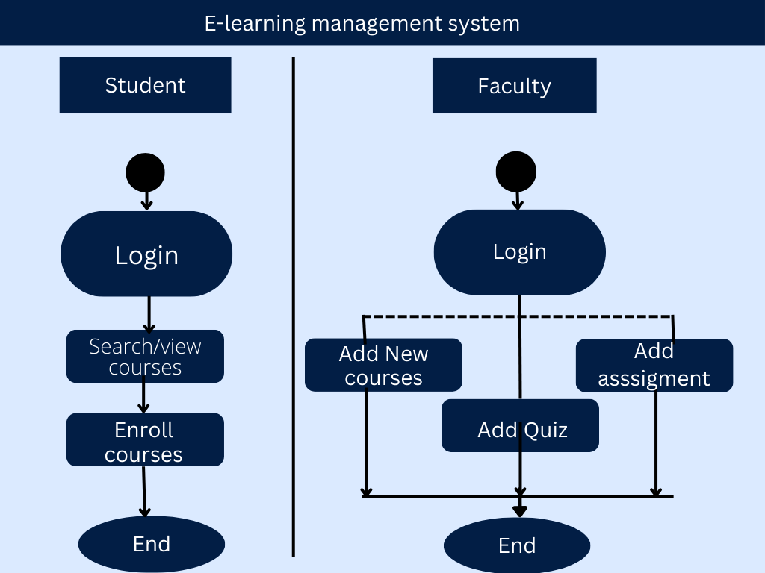
12

Slide 13
7. ER DIAGRAM
13

Slide 14
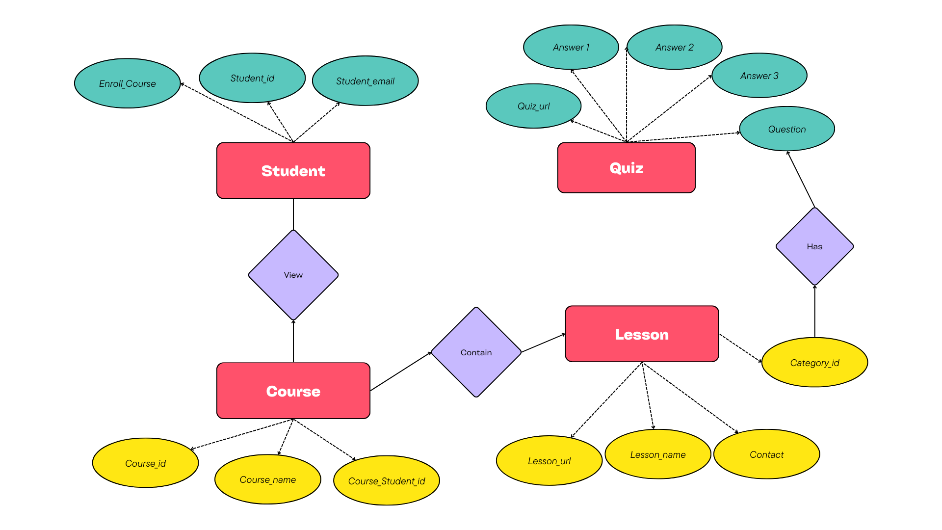
14

Slide 15
8. DATAFLOW DIAGRAM
15

Slide 16
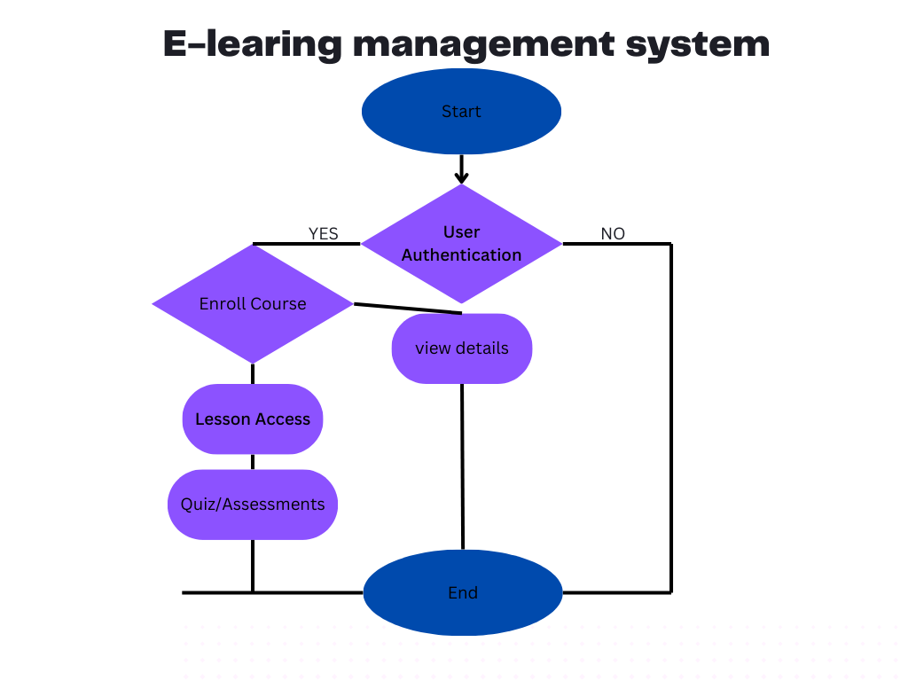
8. DATAFLOW DIAGRAM
16

Slide 17
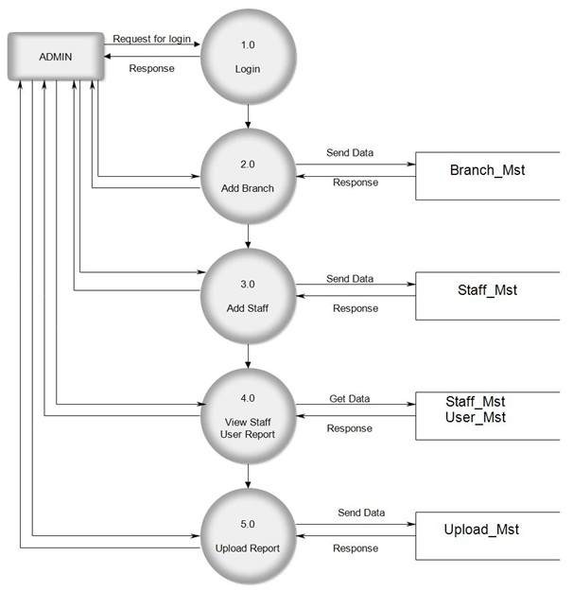
8.2 FIRST LEVEL DFD
17

Slide 18
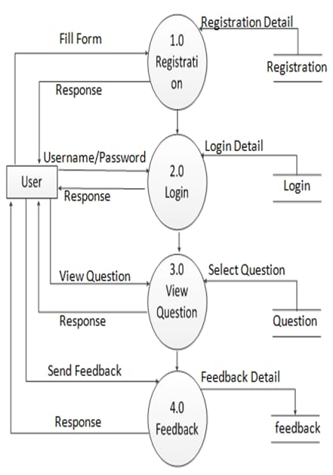
FIRST LEVEL DFD AUCTIONEER SIDE
18

Slide 19
9. DATA DICTIONARY
TABLE NAME
users
Instructor
bids
pwd_reset
19

Slide 20
Users
Table Name : - | users
Primary Key : - | user_id
Description : - | To store user information
Sr. No | Field Name | DataType(Size ) | Constraint | Description | Sample Data
1 | user_id | Int (3) | Primary Key | To store user_id.& id is Auto Increm ent. | 101
2 | username | Varchar (50) | Not Null | To store the Username. | My Username
3 | user_email | Varchar (50) | Not Null | To store the User’s Email. | myemail@gmail.com
4 | user_password | Varchar (150) | Not Null | To store the User’s Passw--ord. | $2y$10$5v0DlzDlSXfyExAB dHr/dOe…
5 | user_image | Text | Not Null | To store the User’s Image path. | user_image.jpg
6 | user_phone | Int(10) | Not Null | To store the User’s Phone number. | 9675465756
7 | user_role | Varchar (15) | Not Null | To store the User’s Role. | admin

Slide 21
Instructor
Table Name : - | Instructor
Primary Key : - | Instructor_id
Foreign Key :- | Instructor_user_id (Ref – users (user_id))
Description :- | To store Instructor Information in Details.
Sr. No | Field Name | DataType (Size) | Constraint | Description | Sample Data
1 | instructor_id | Int(3) | Primary key | To store the instructor_id. & Id is Auto Increment. | 1
2 | instructor_name | Varchar(50) | Not Null | To store the instructor name. | Laptop
3 | instructor_desc | Text | Not Null | To store the instructor description. | This laptop is very fast.
4 | instructor_price | Int(10) | Not Null | To store the instructorprice. | 1234
5 | instructor_image | Text | Not Null | To store the instructor image path. | newimage.jpg

Slide 22
6 | instructor_create_date | date | Not Null | To store the instructor created date | 2021-12-02
7 | instructor_status | Varchar (10) | Not Null | To store the instructor status. | Active
8 | instructor_user_id | Int (3) | Foreign Key | To store the instructor user id. | 15
9 | instructor | Int (3) | Not Null | To store instructor’s Id. | 12

Slide 23
Quiz
Table Name : - | quiz
Primary Key : - | quiz _id
Foreign Key :- | quiz _instructor_id (Ref – products(product_id)) & bid_user_id(Ref – users(user_id))
Description :- | To store information of all quiz.

Slide 24

10. INPUT DESIGN

Slide 25
10.1 INPUT DESIGN FOR ADMIN SIDE

Slide 26
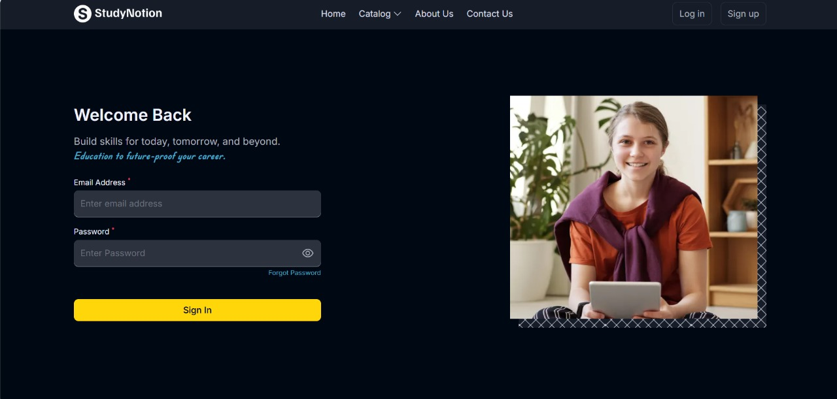
Login page
Description: - It is login page. Admin can login by providing information.

Slide 27
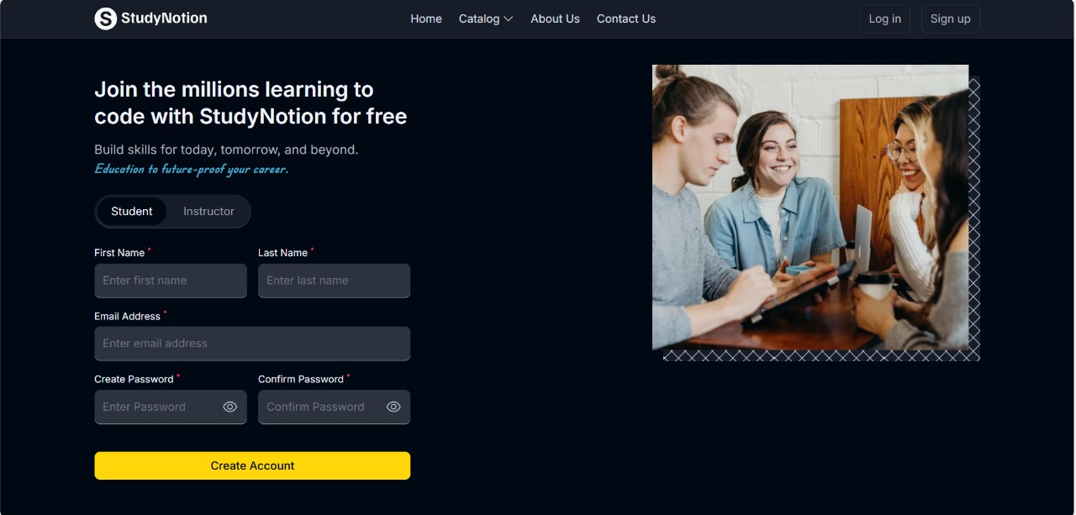
Login page with validation
Description: - It is login page with validation. If any field is empty then login page will give one error message as popup.

Slide 28
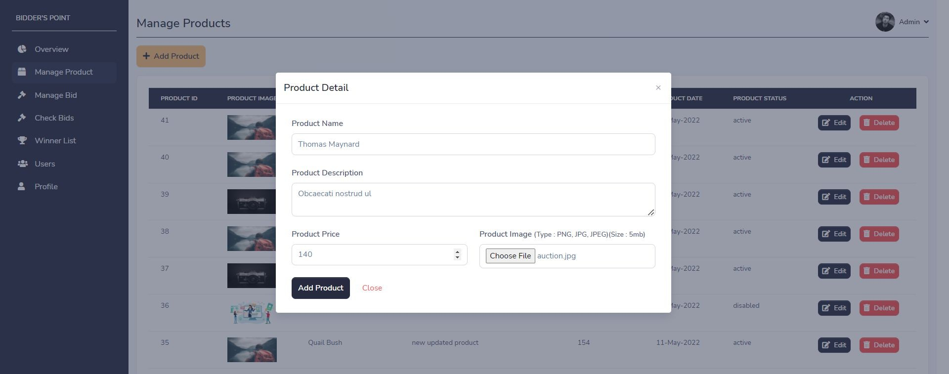
Add product page
Description: - It is add product page. Admin can add product by click on “add product” button and providing product information.

Slide 29
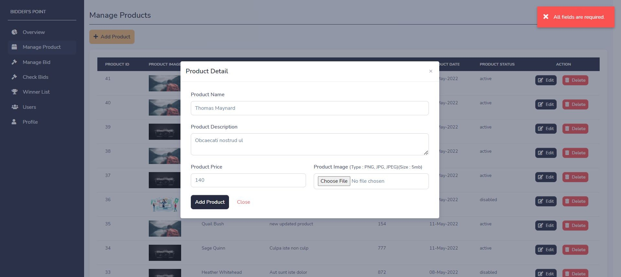
Add product page with validation
Description: - It is add product page with validation. If any field is empty then add product page will give one error message as popup.

Slide 30
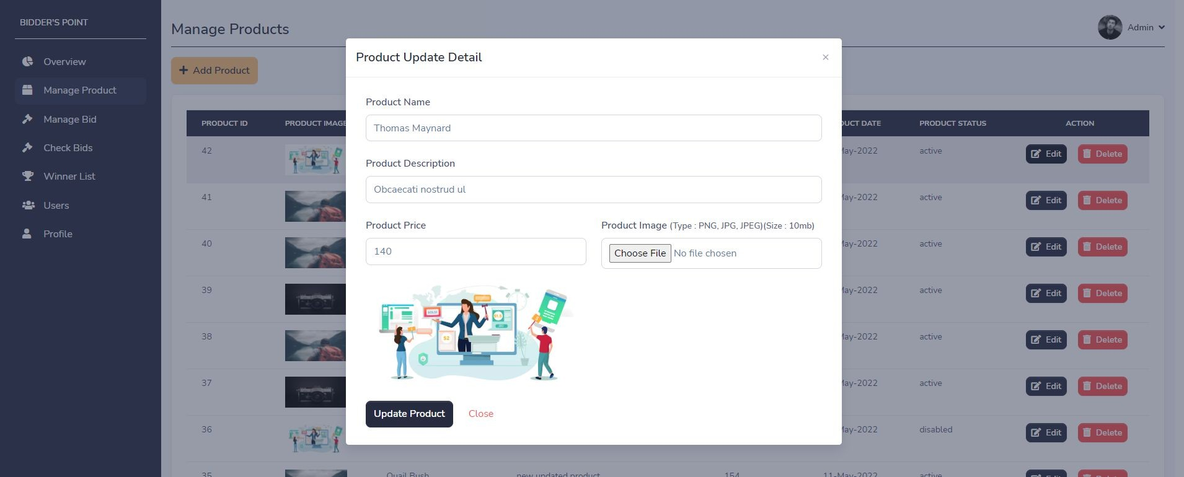
Edit product page
Description: - It is edit product page. Admin can change product details by clicking on “edit” button on any particular product.

Slide 31
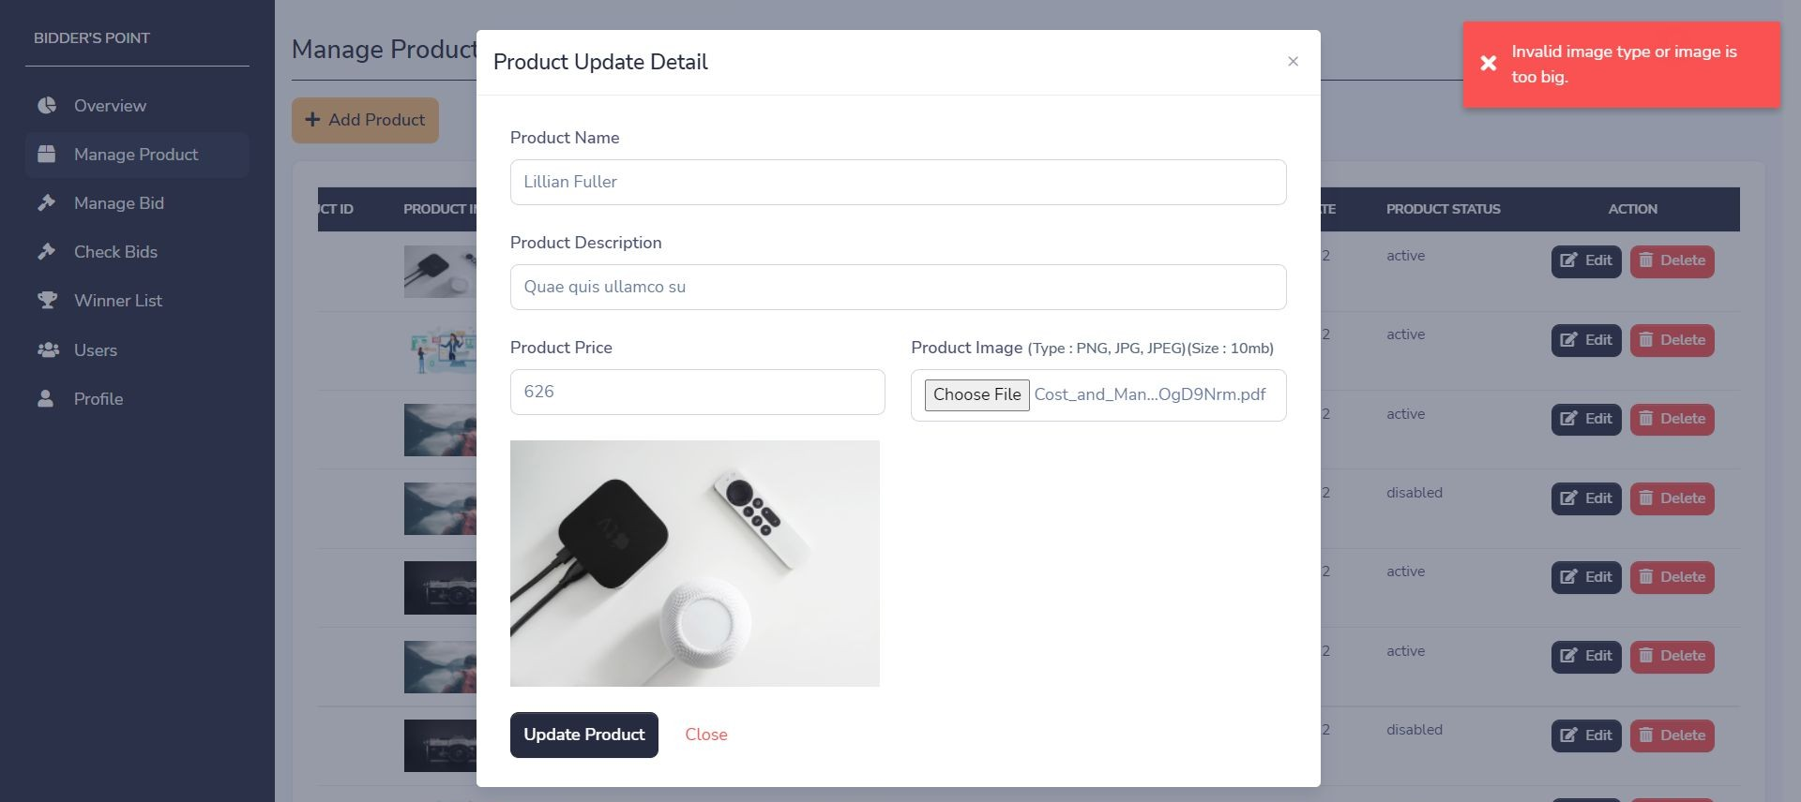
Edit product page with validation
Description: - It is update user page with validation. If image has invalid type or image is too big then page will give one error message as popup.

Slide 32
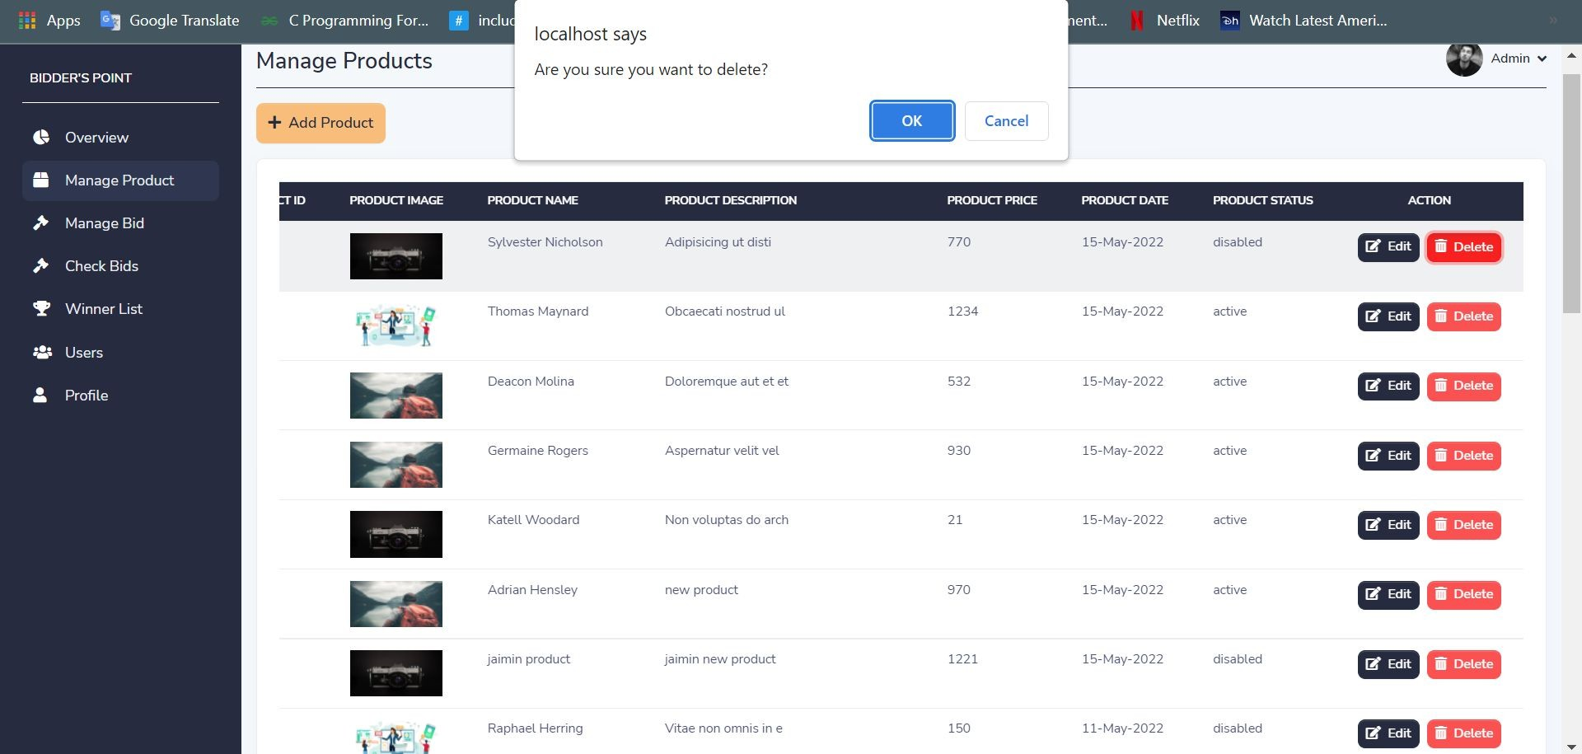
Delete product with confirmation
Description: - It is delete product functionality with confirmation message. Admin can delete product by clicking on "delete" button.

Slide 33
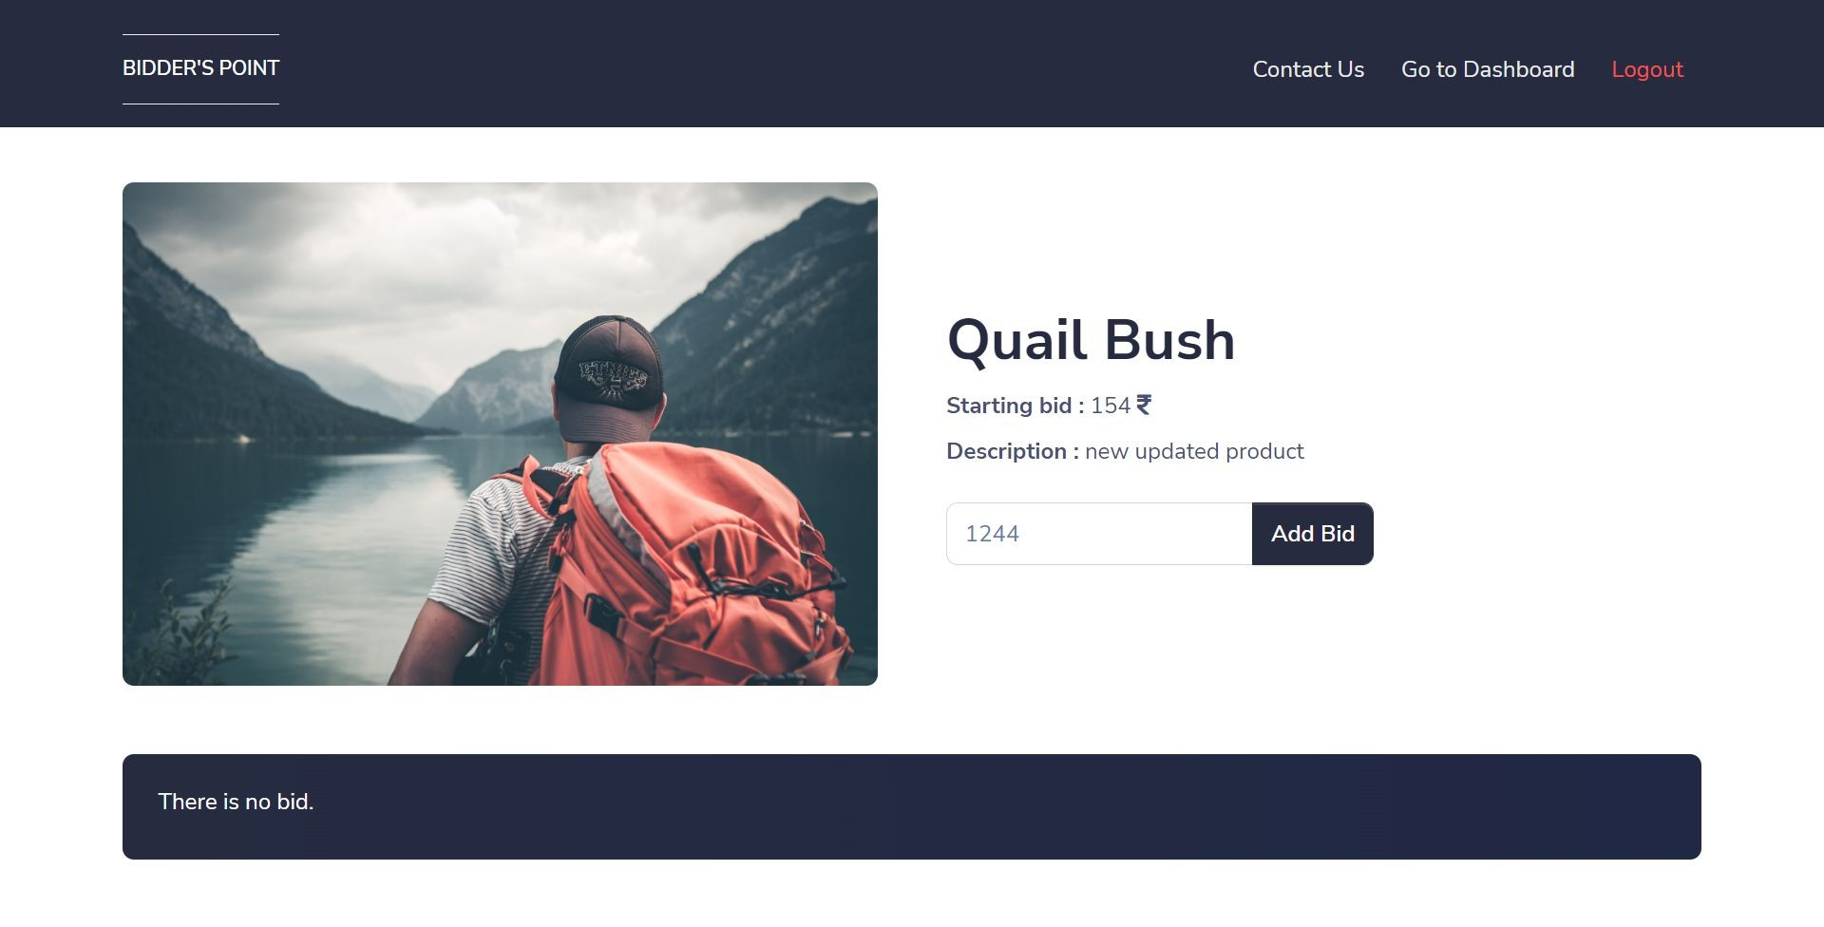
Add bid page
Description: - It is add bid page. Admin can add bid by clicking on “add bid” button on any particular product.

Slide 34
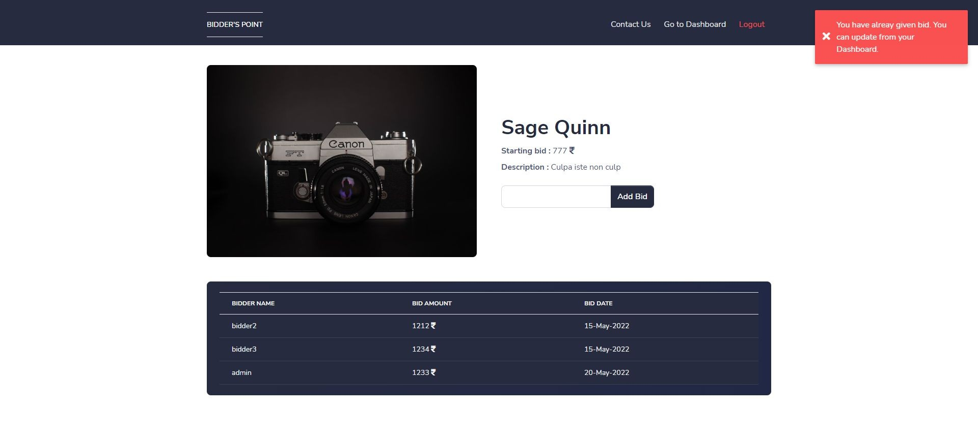
Add bid page with validation
Description: - It is add bid page with validation. If admin has already given bid and we again try to give bid then add bid page will give one error message as popup.

Slide 35
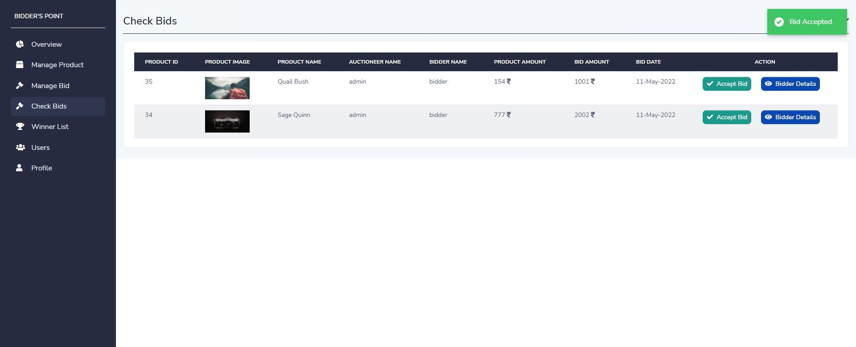
Accept bid page
Description: - It is accept bid page. Admin can accept any bid by clicking on “Accept bid” button on any particular bid.

Slide 36
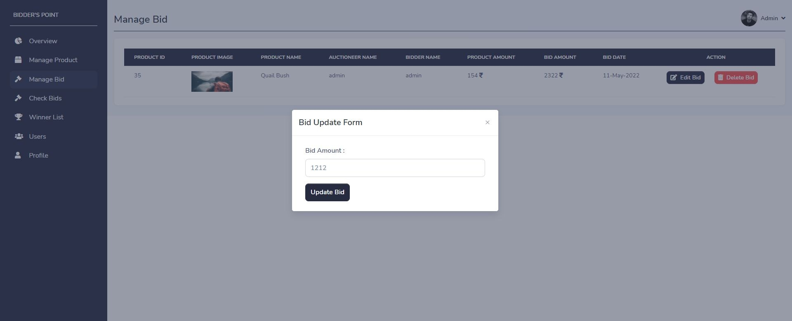
Edit bid page
Description: - It is edit bid page. Admin can change bid by clicking on “edit bid” button on any particular bid.

Slide 37
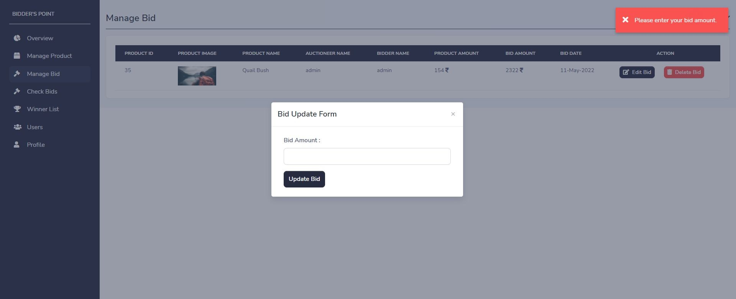
Edit bid page with validation
Description: - It is edit bid page with validation. If bid is empty then edit bid page will give one error message as popup.

Slide 38
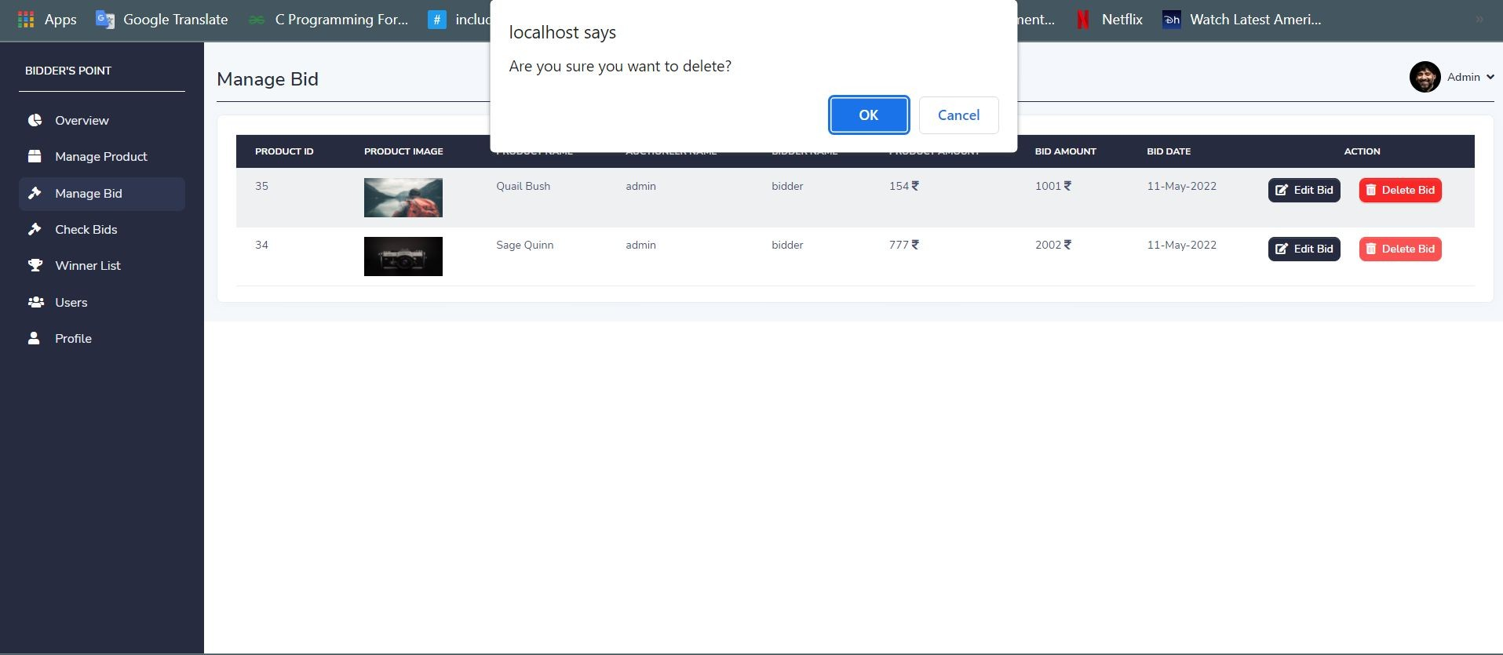
Delete bid with confirmation
Description: - It is delete bid functionality with confirmation message. Admin can delete any bid by clicking on "delete" button.

Slide 39
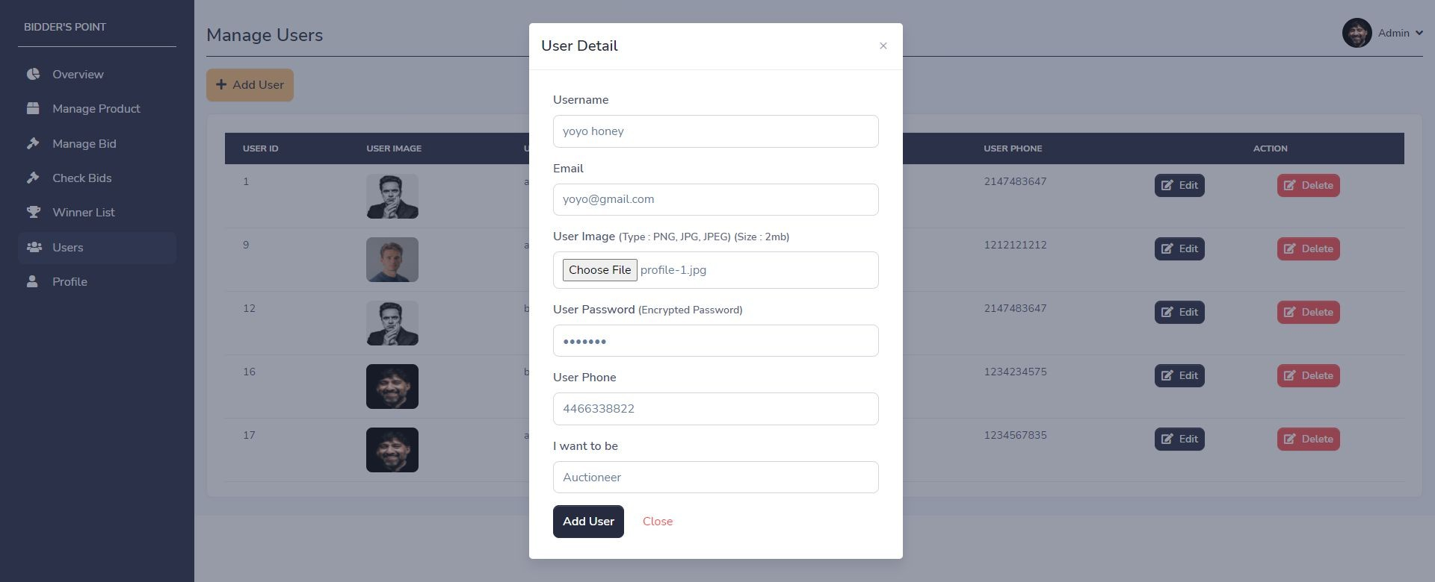
Add user page
Description: - It is add user page. Admin can add user by clicking on “add user” button.

Slide 40
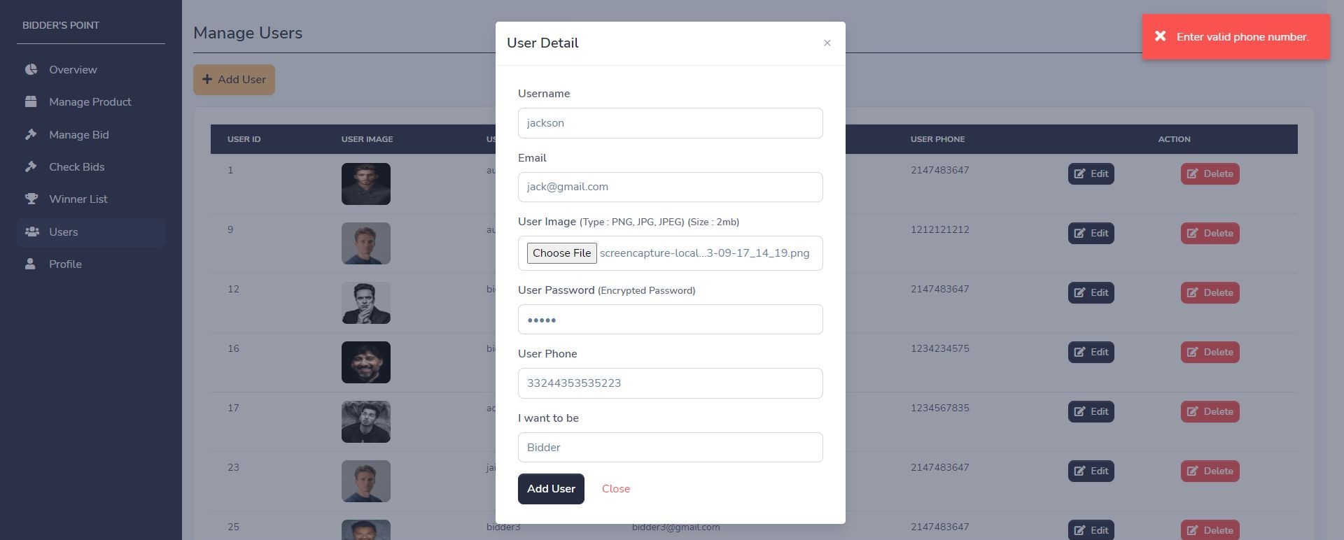
Add user page with validation
Description: - It is add bid page with validation. If mobile number is not equal to 10 digits then add user page will give one error message as popup.

Slide 41
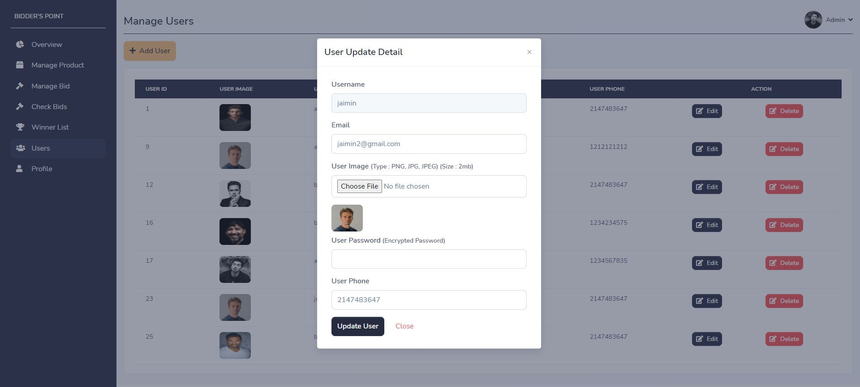
Update user page
Description: - It is update user page. Admin can update user by clicking on “edit” button on particular user.

Slide 42
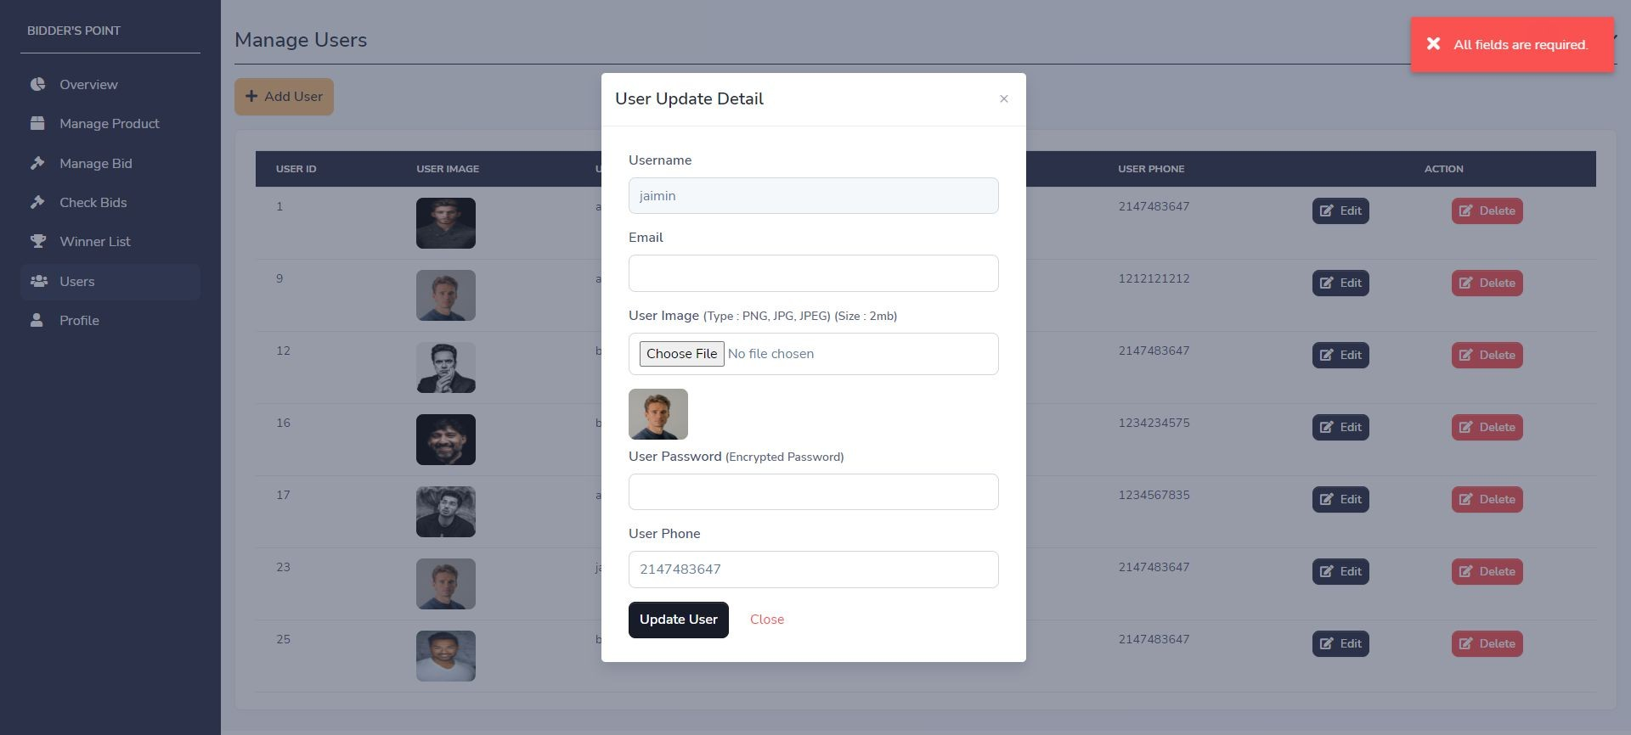
Update user page with validation
Description: - It is update user page with validation. If any field is empty then update user page will give one error message as popup.

Slide 43
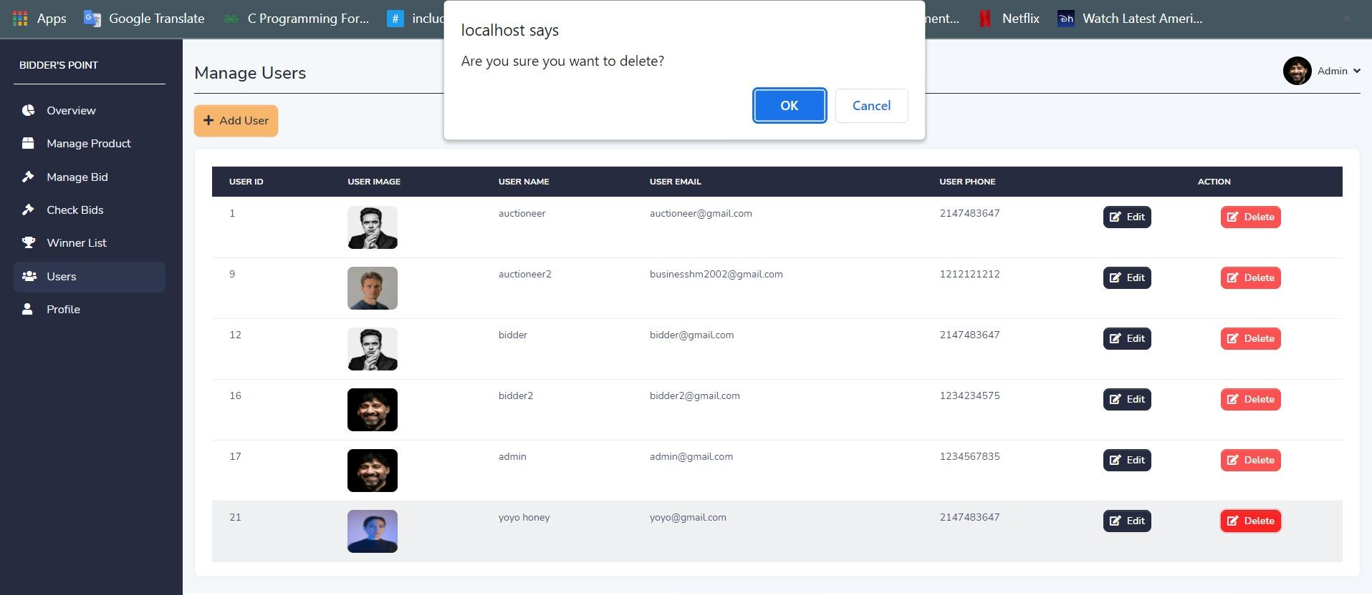
Delete user with confirmation
Description: - It is delete user functionality with confirmation message. Admin can delete any user by clicking on "delete" button.

Slide 44
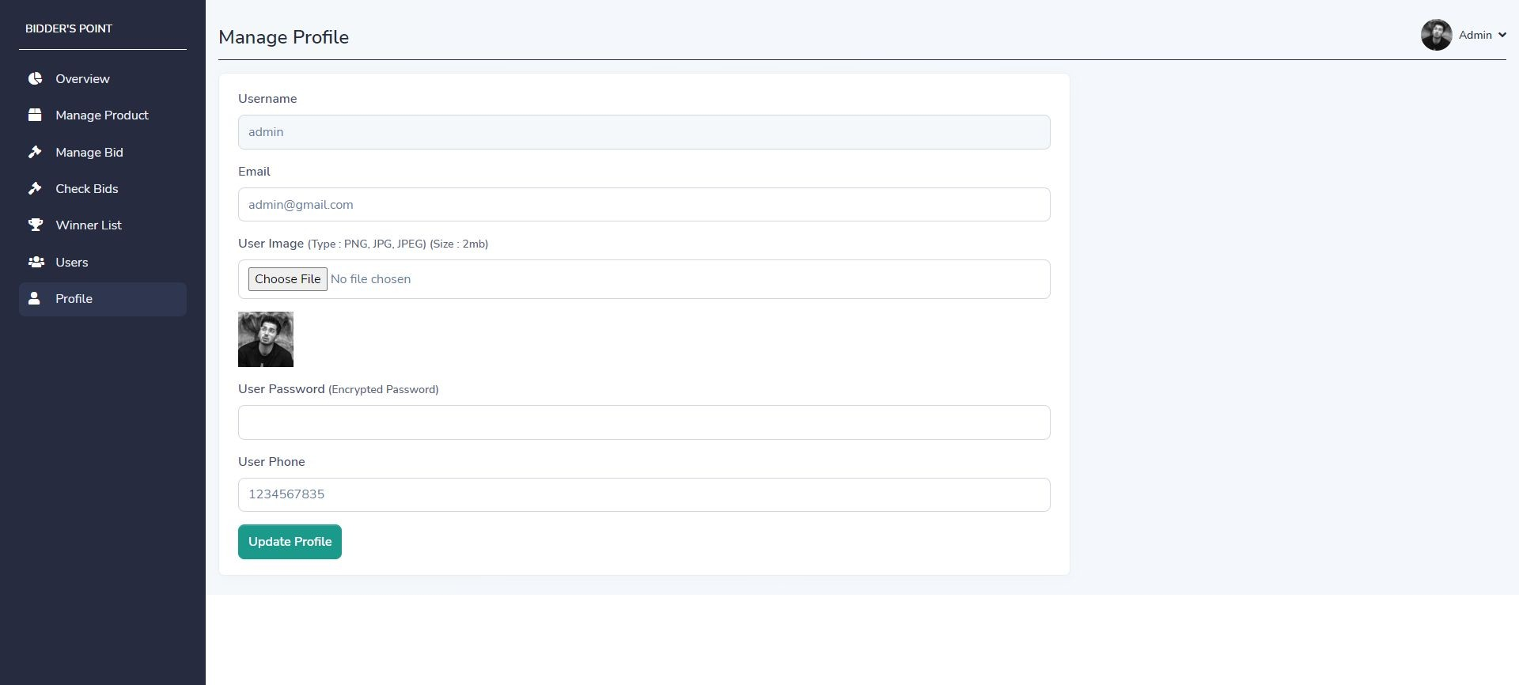
Update profile page
Description: - It is update profile page. Admin can update profile by clicking on “update profile” button.

Slide 45
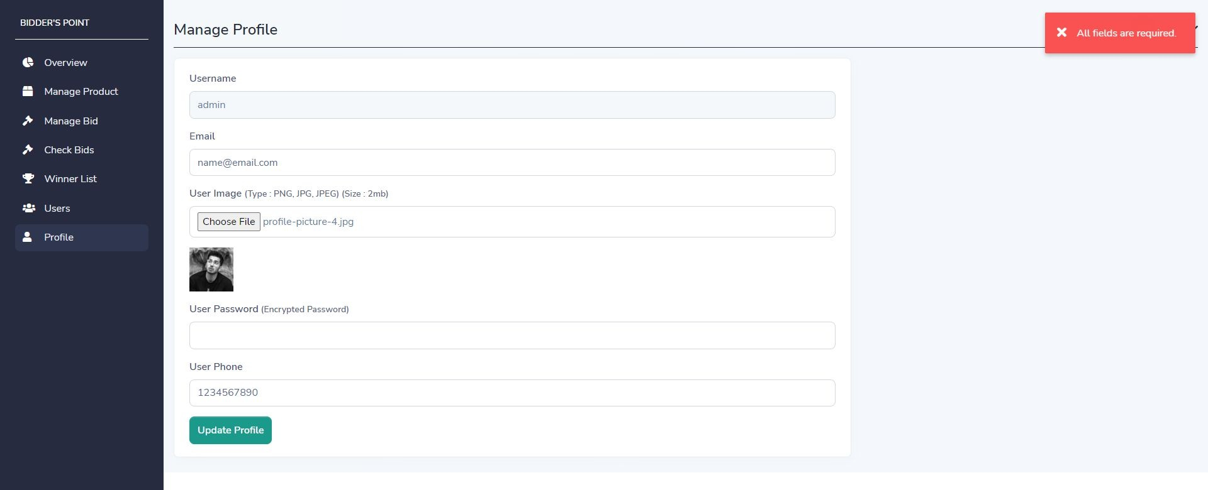
Update profile page with validation
Description: - It is update profile page with validation. If any field is empty then update profile page will give one error message as popup.

Slide 46
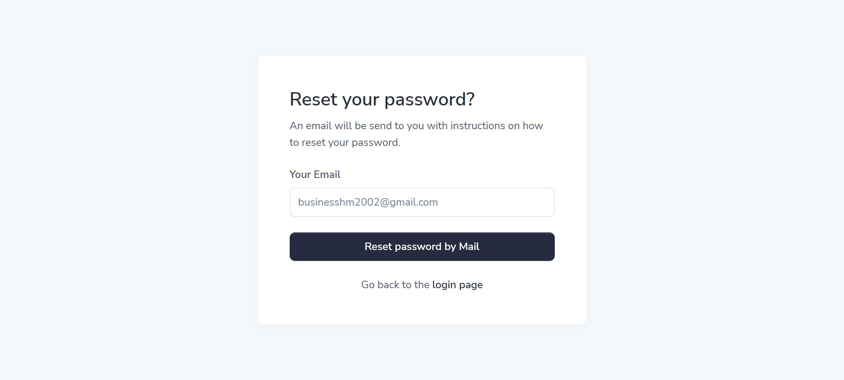
Forget password page
Description: - It is forgot password page. Admin can forgot password through this page. It will send link to email address where you can set your new password.

Slide 47
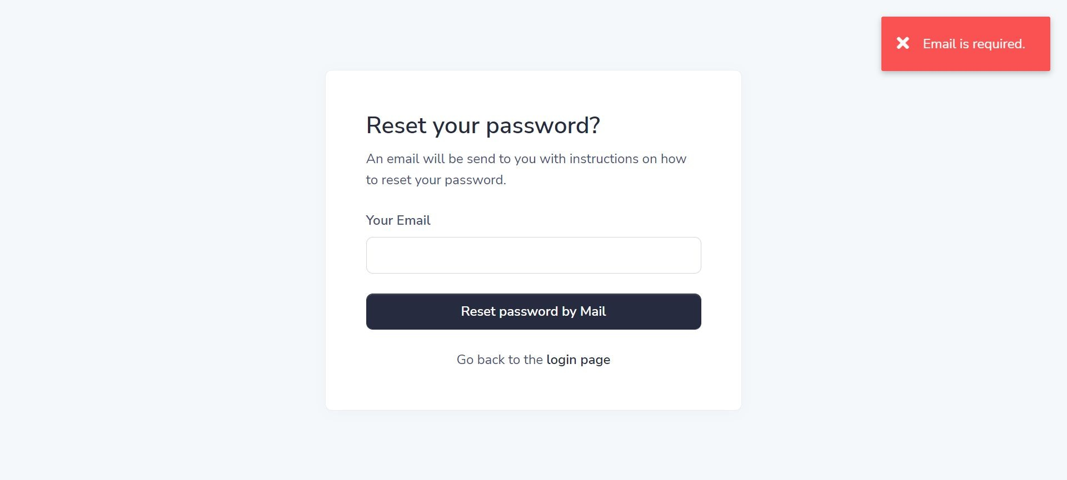
Forget password page with validation
Description: - It is forgot password page with validation. If the entered email is not valid then the forget password form will not send reset link to email and give one error message as popup.

Slide 48
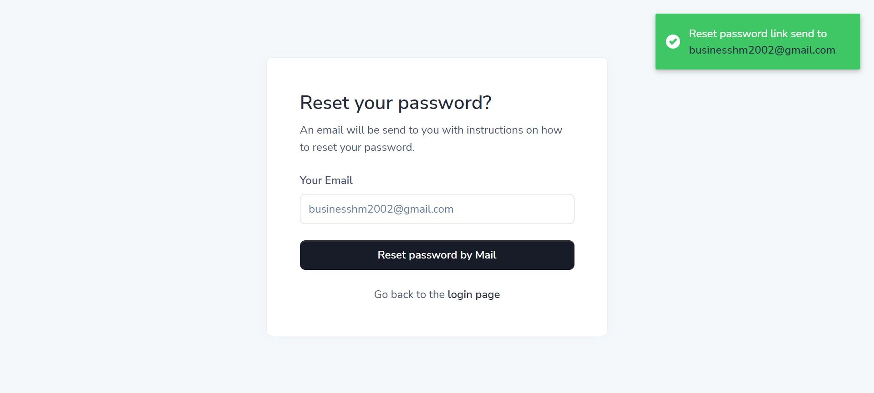
Forget password page with confirmation
Description: - It is forgot password confirmation page. If the entered email is valid then it will send reset password link to that mail address.

Slide 49
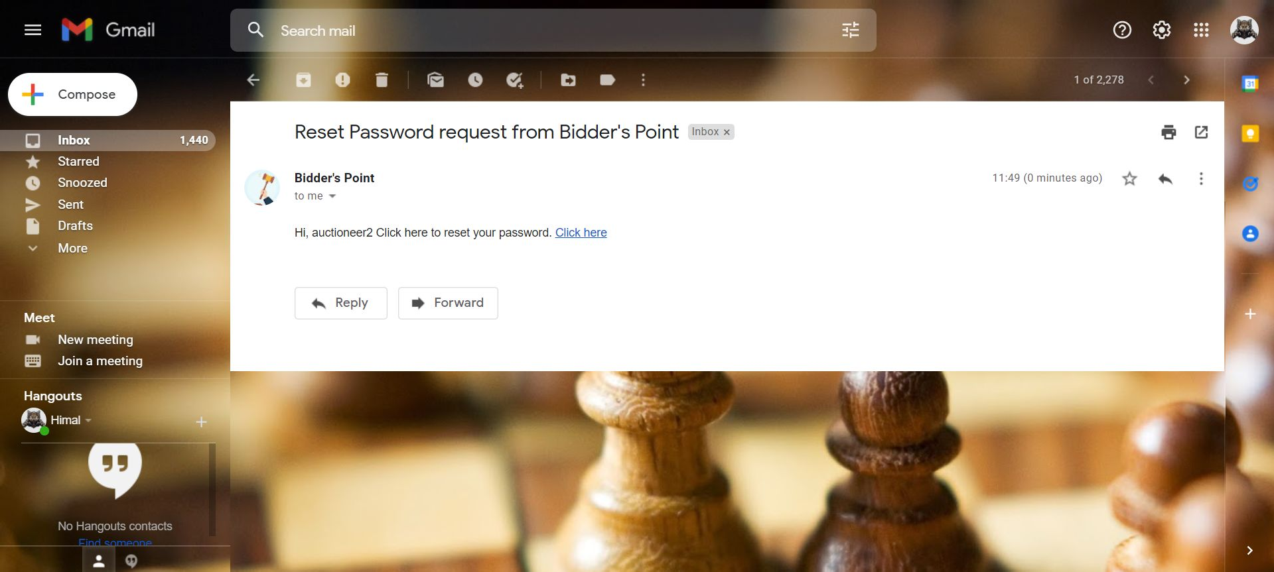
Forget password link sent to email
Description: - System has sent forget password link to email. Where user can click on “click here” button and set new password.

Slide 50
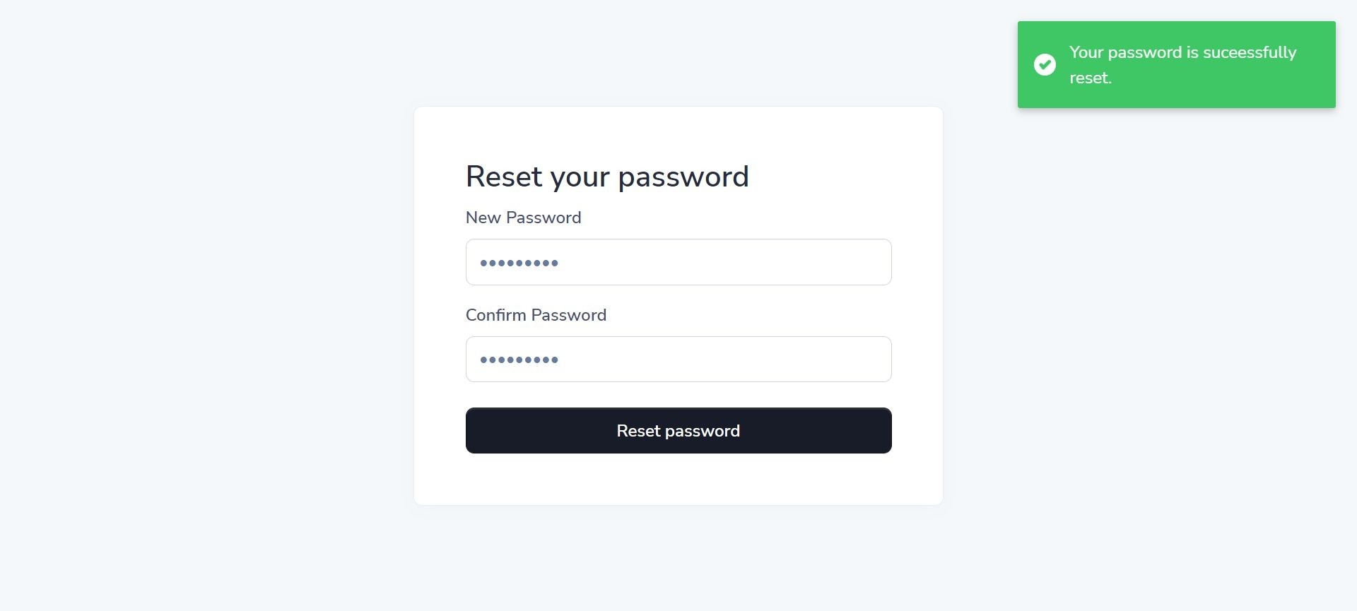
Reset password page
Description: - It is reset password page with confirmation message. If the entered password and confirm password is equal and valid then your new password will change into database and page will give one success message as popup.

Slide 51
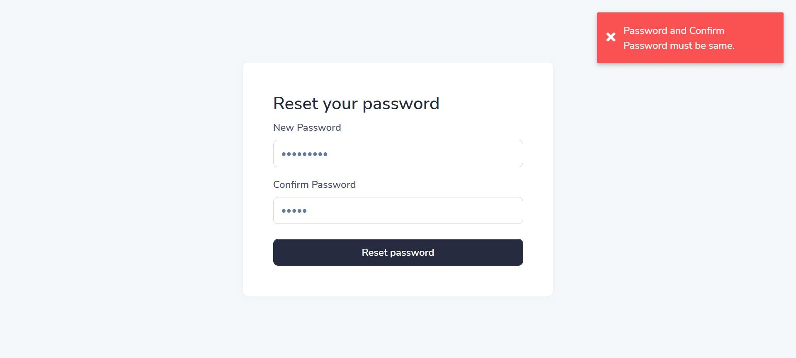
Forget password page with validation
Description: - It is reset password page with validation. If the entered password and confirm password is not equal then page will give one error message as popup.

Slide 52
10.2 INPUT DESIGN FOR AUCTIONEER SIDE

Slide 53
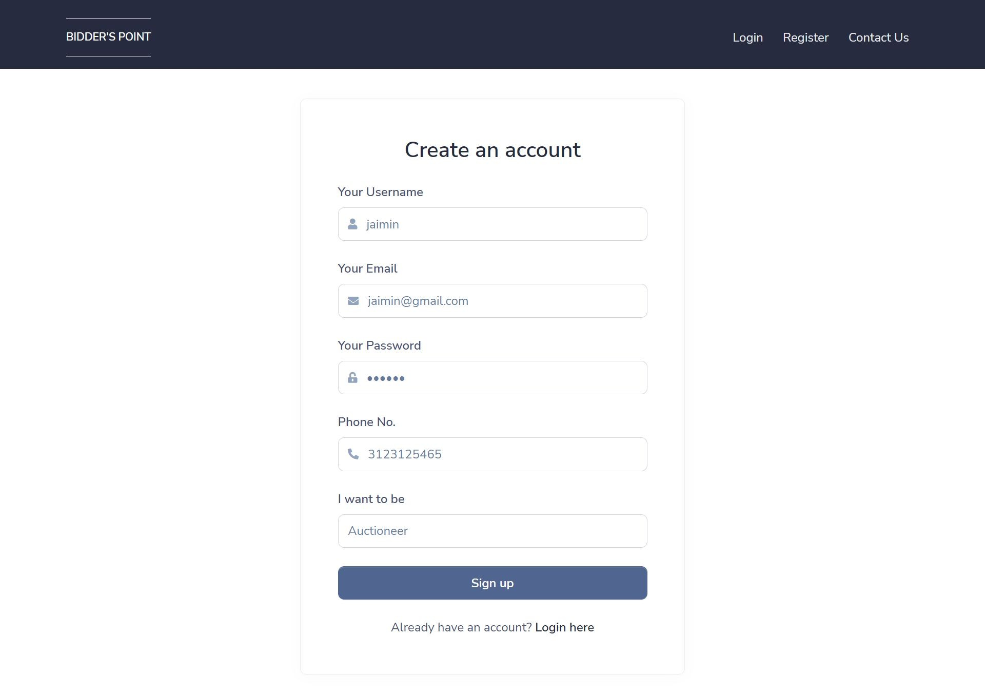
Registration page
Description: - It is registration page. User can register as auctioneer by providing some information.

Slide 54
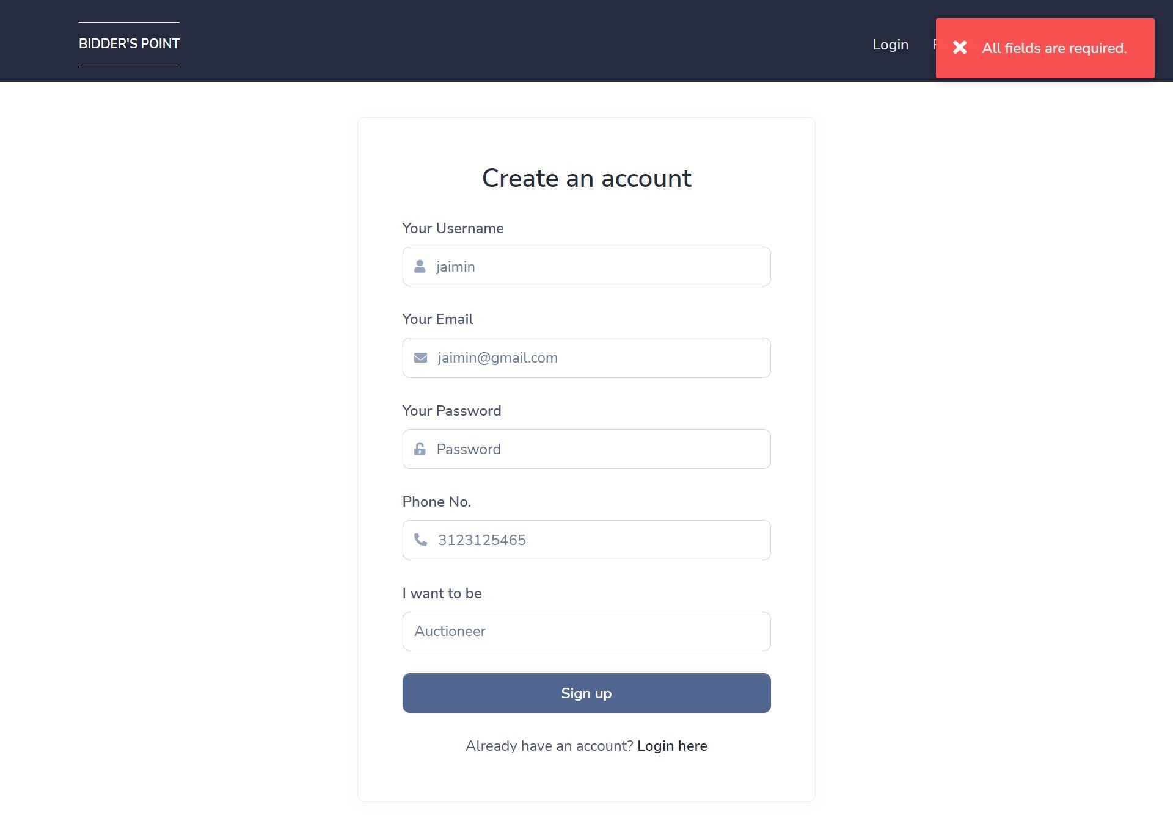
Registration page with Validation
Description: - It is registration page with validation. User must provide all the details. If there is any empty field then it will give one error message as popup.

Slide 55
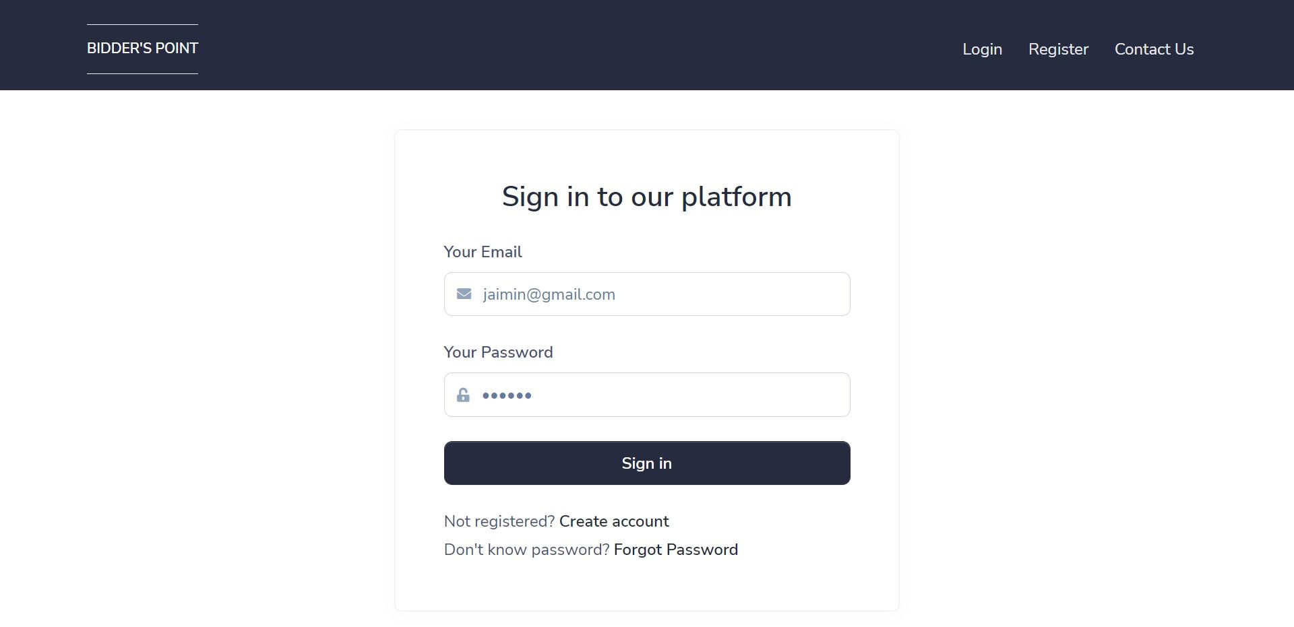
Login page
Description: - It is login page. Auctioneer can login by providing information.

Slide 56
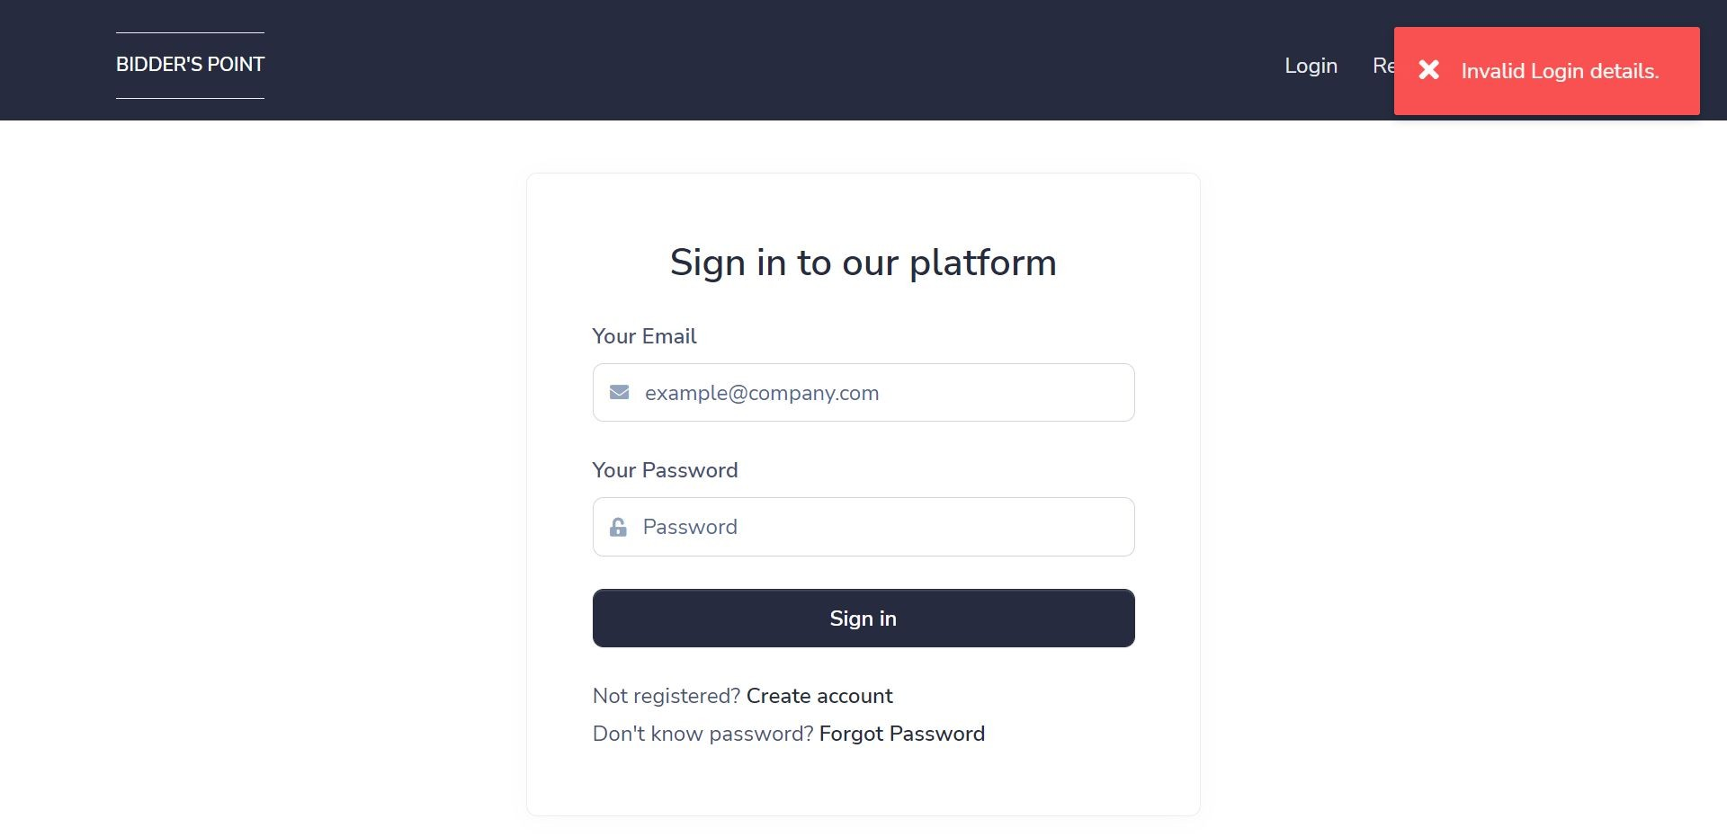
Login page with validation
Description: - It is login page with validation. If any fields are empty then login page will give one error message as popup.

Slide 57
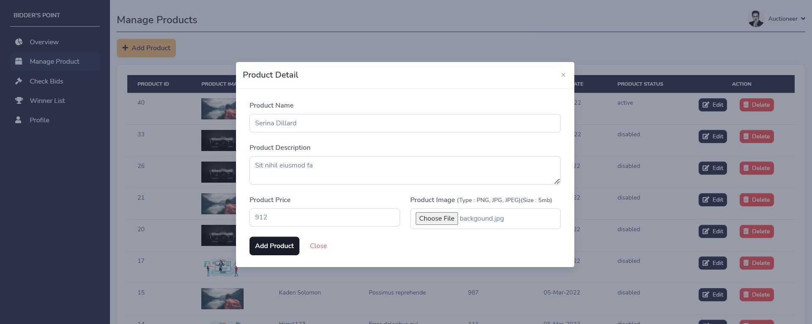
Add product page
Description: - It is add product page. Auctioneer can add product by click on “add product” button and providing product information.

Slide 58
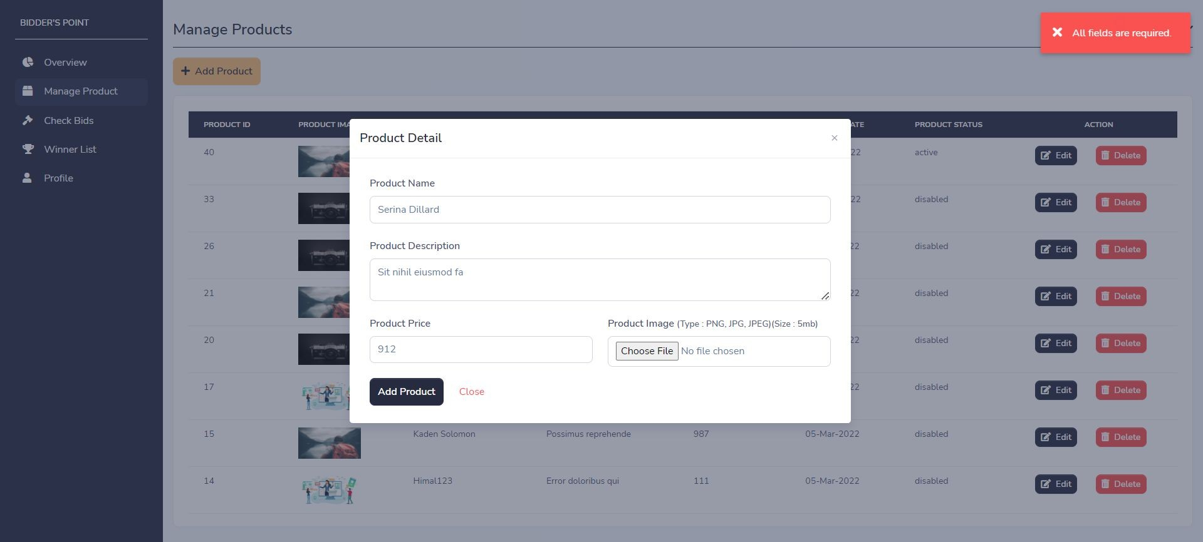
Add product page with validation
Description: - It is add product page with validation. If any field is empty then add product page will give one error message as popup.

Slide 59
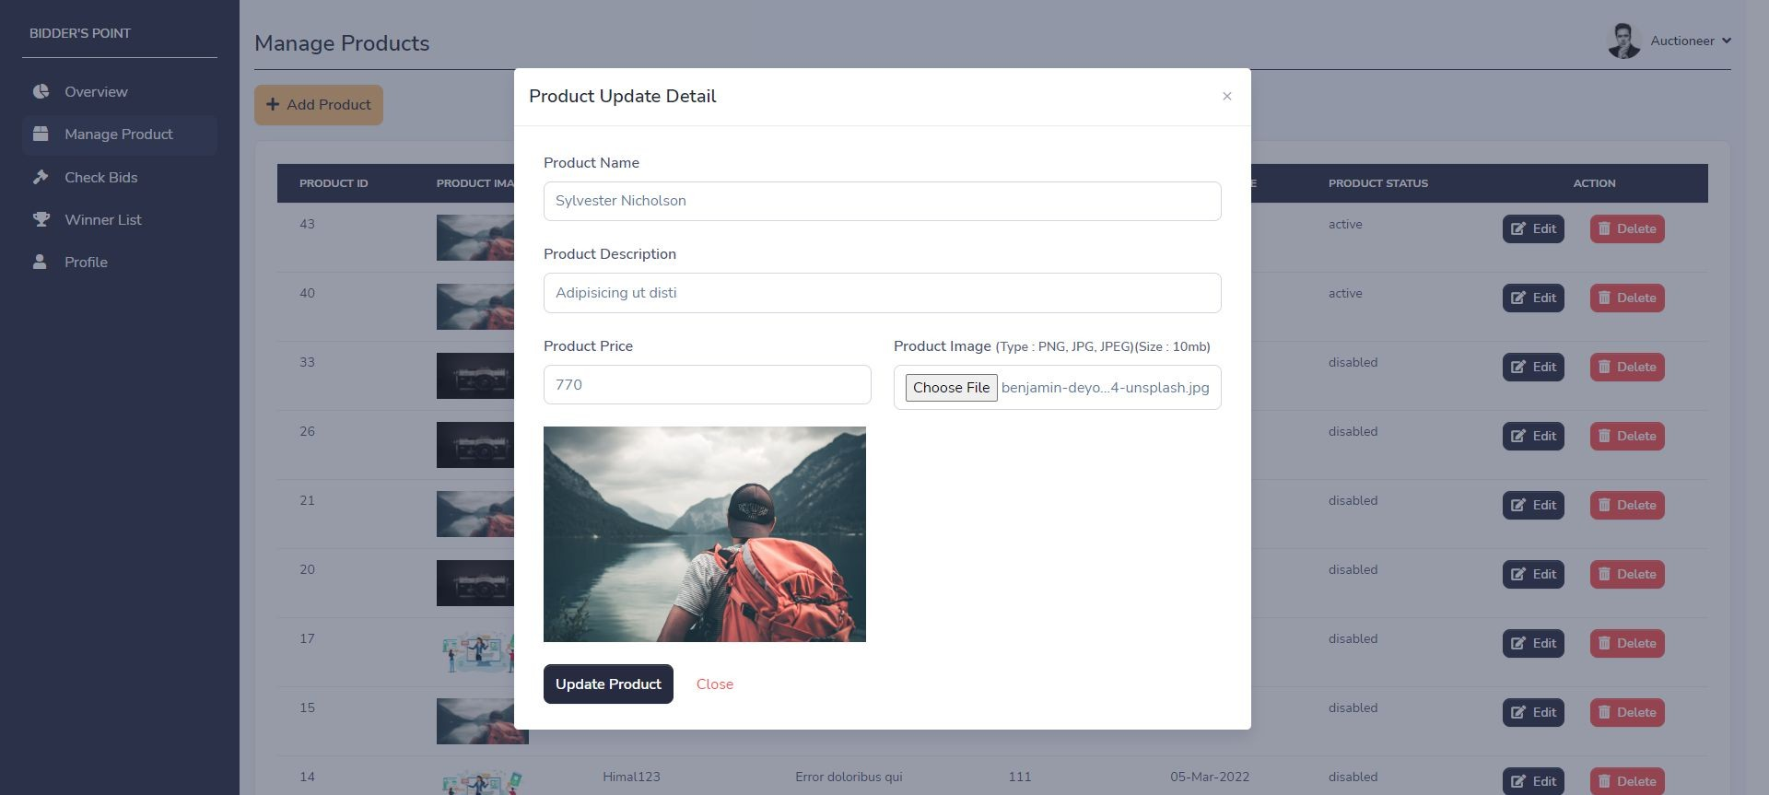
Edit product page
Description: - It is edit product page. Auctioneer can change product details by clicking on “edit” button on any particular product.

Slide 60
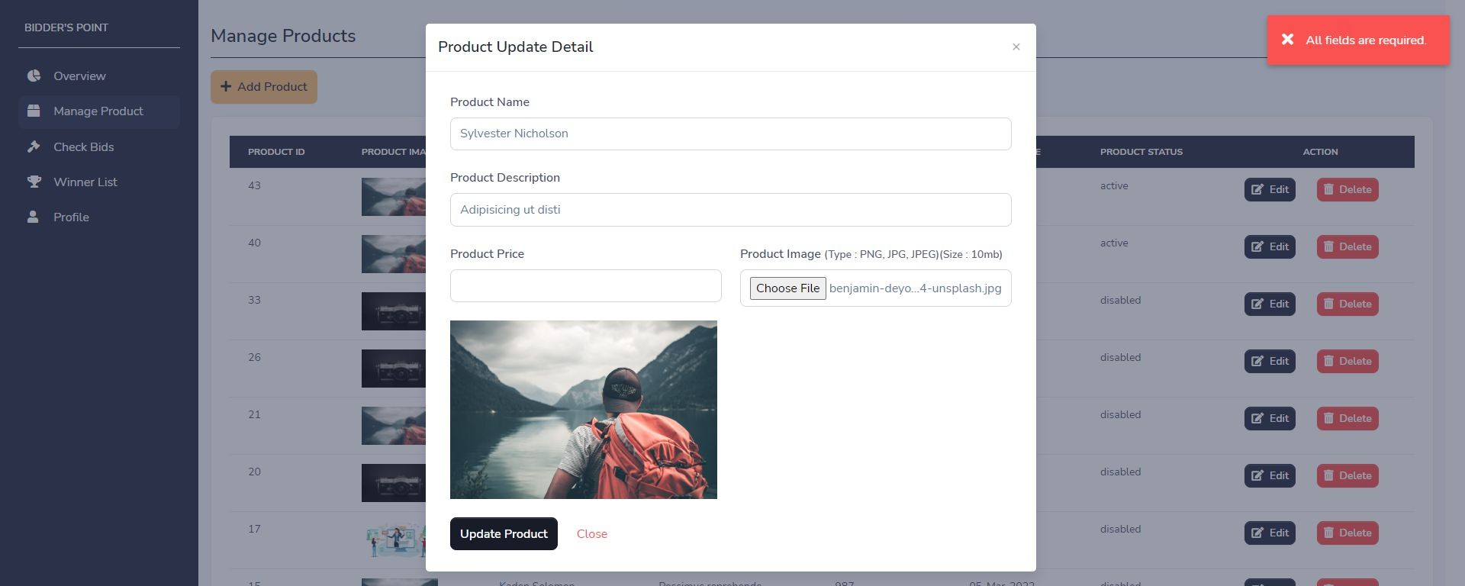
Edit product page with validation
Description: - It is edit product page with validation. If any field is empty then edit product page will give one error message as popup.

Slide 61
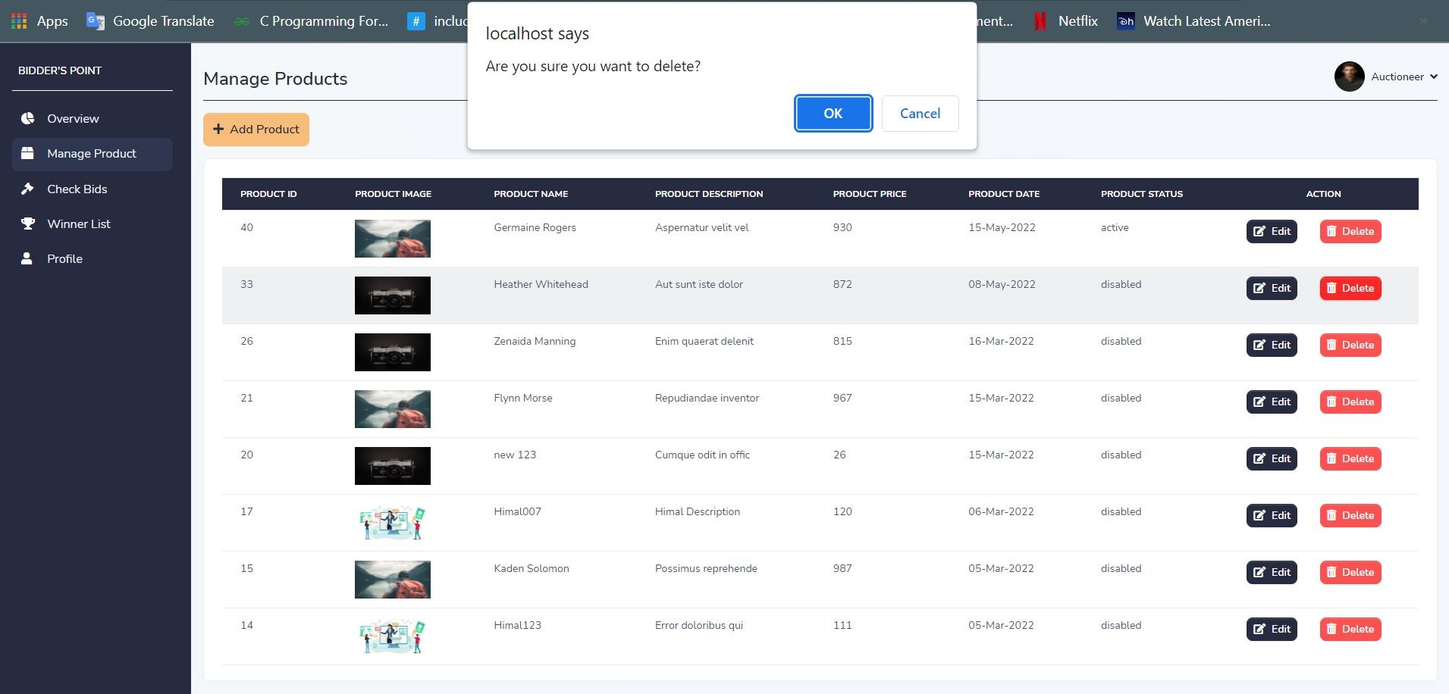
Delete product with confirmation
Description: - It is delete product functionality with confirmation message. Auctioneer can delete any product by clicking on "delete" button.

Slide 62
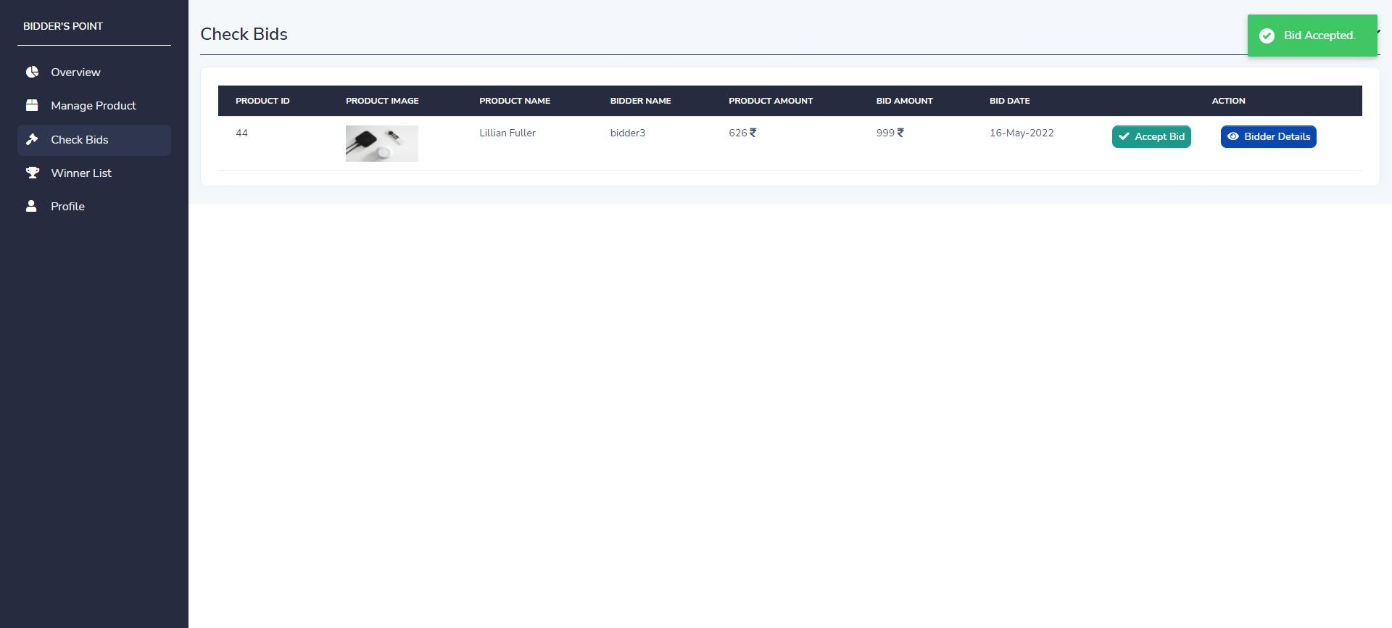
Accept bid page
Description: - It is accept bid page. Auctioneer can accept bid by clicking on “Accept bid” button on any particular bid.

Slide 63
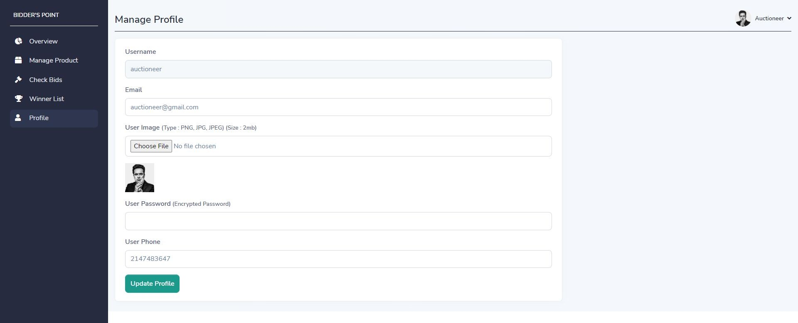
Update profile page
Description: - It is update profile page. Auctioneer can update profile by clicking on “update profile” button.

Slide 64
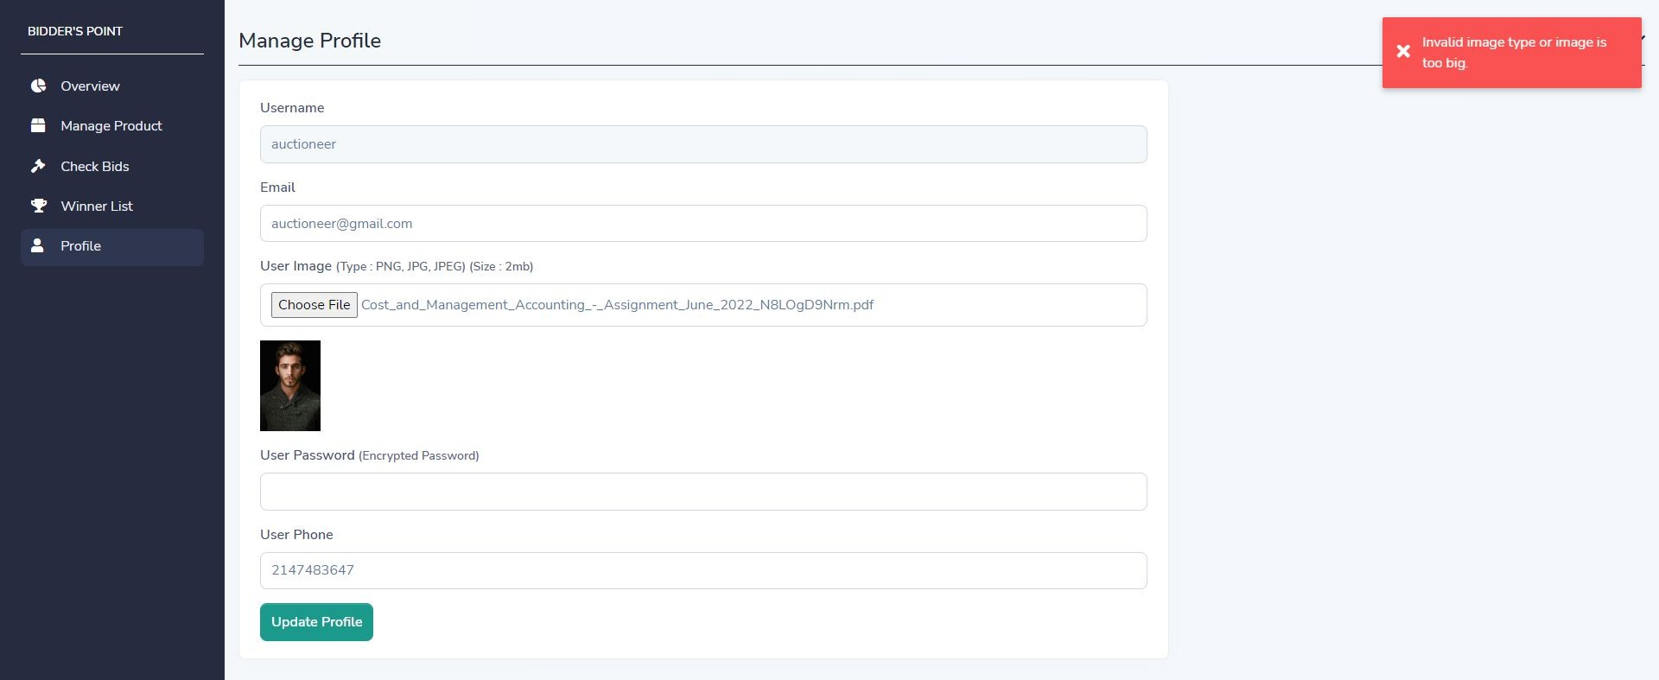
Update profile page with validation
Description: - It is update profile page with validation. If image has invalid type or image is too big then page will give one error message as popup.

Slide 65
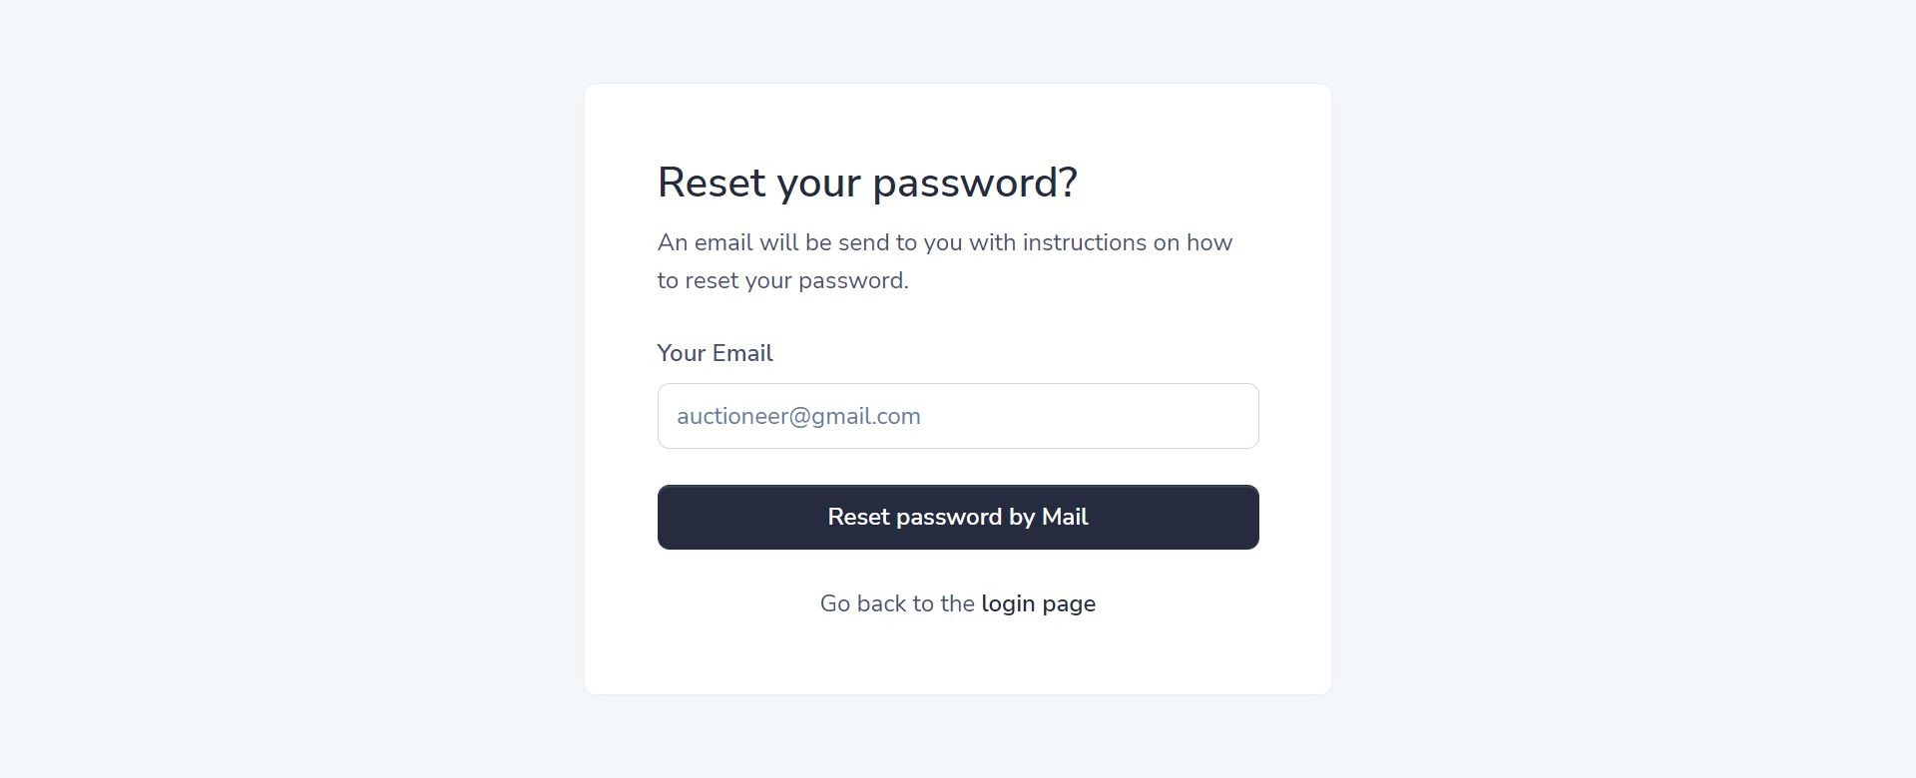
Forget password page
Description: - It is forgot password page. Auctioneer can forgot password through this page. It will send link to email address where you can set your new password.

Slide 66
Forget password page with validation
Description: - It is forgot password page with validation. If the entered details are valid then the forgot password form will send reset link to email otherwise not.

Slide 68
10.3 INPUT DESIGN FOR BIDDER SIDE

Slide 69
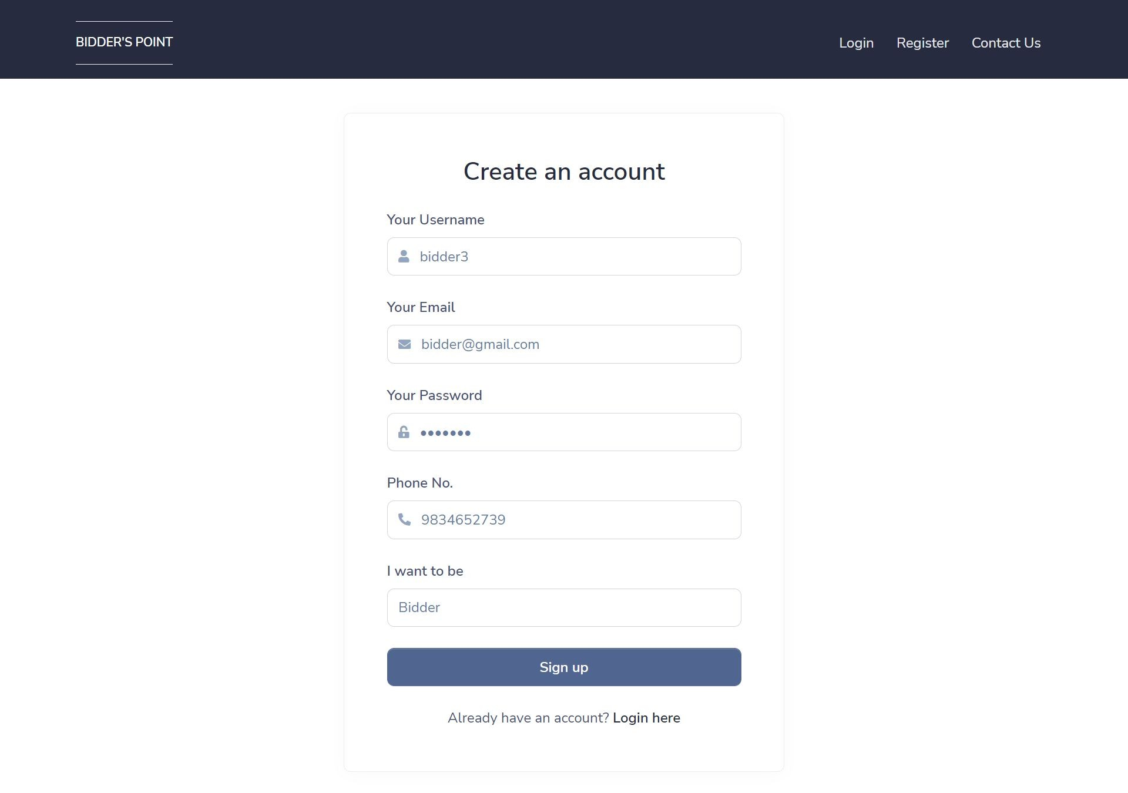
Registration page
Description: - It is registration page. User can register as a bidder by providing some information.

Slide 70
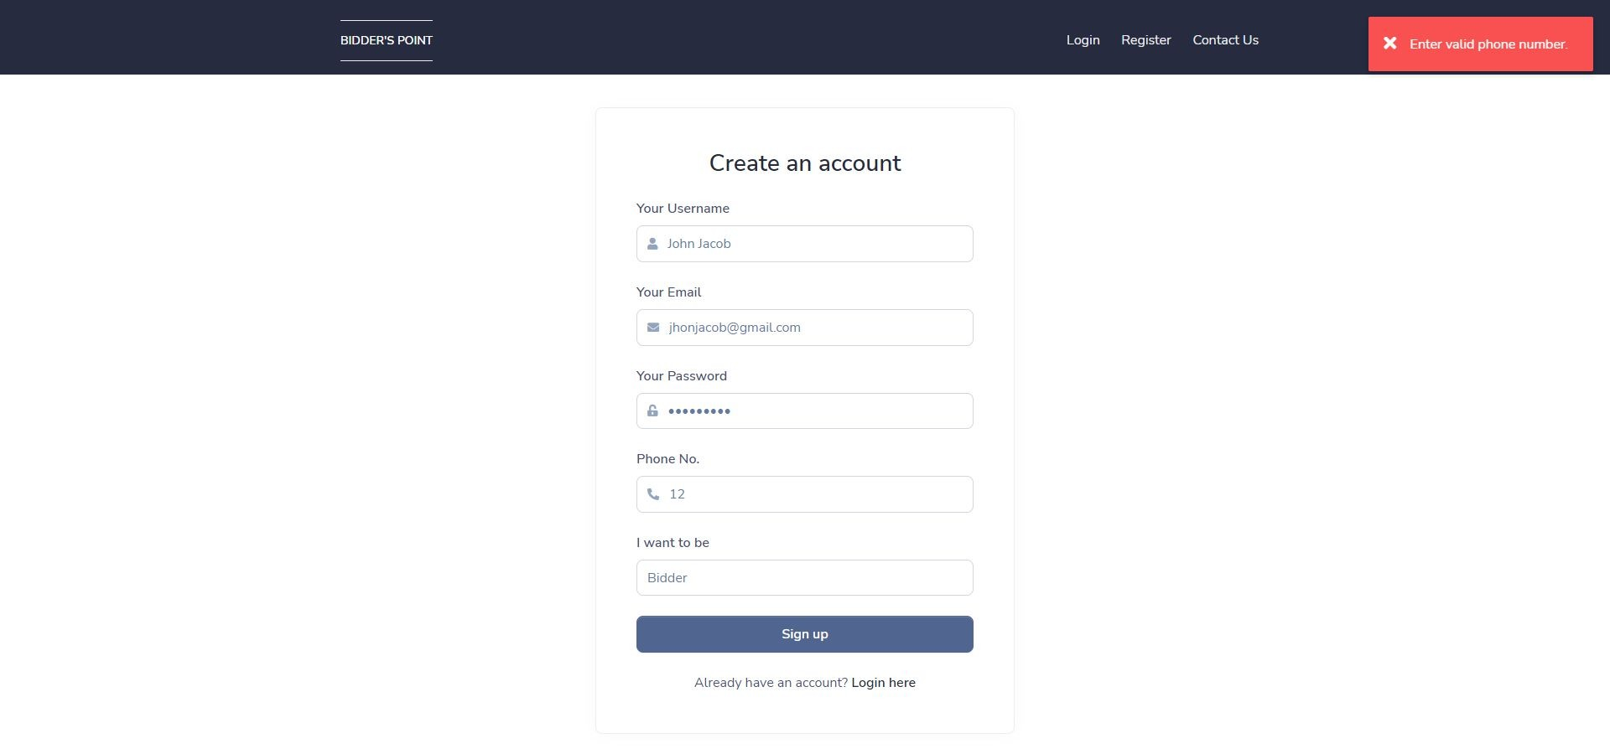
Registration page with Validation
Description: - It is registration page with validation. If mobile number is not equal to 10 digits then it will give one error message as popup.

Slide 71

Login page
Description: - It is login page. Bidder can login by providing information.

Slide 72
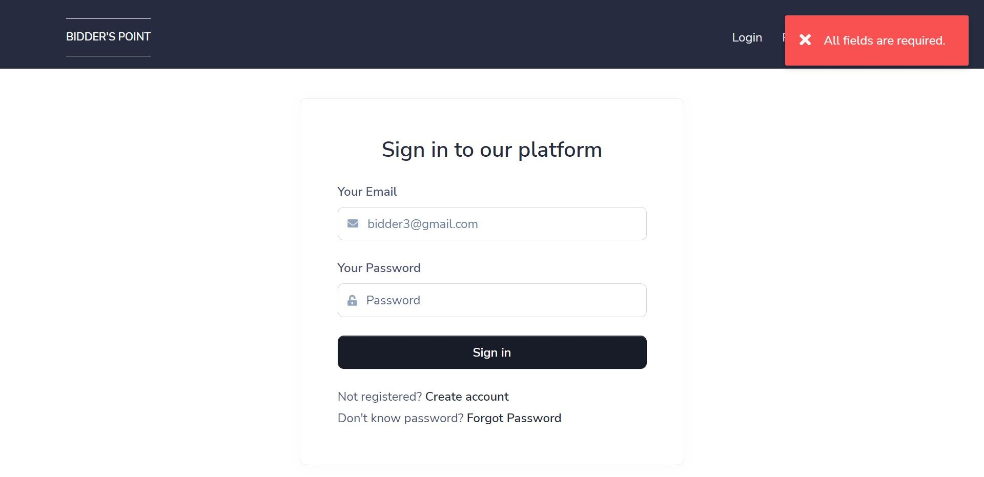
Login page with validation
Description: - It is login page with validation. If any fields are empty then login page will give one error message as popup.

Slide 73
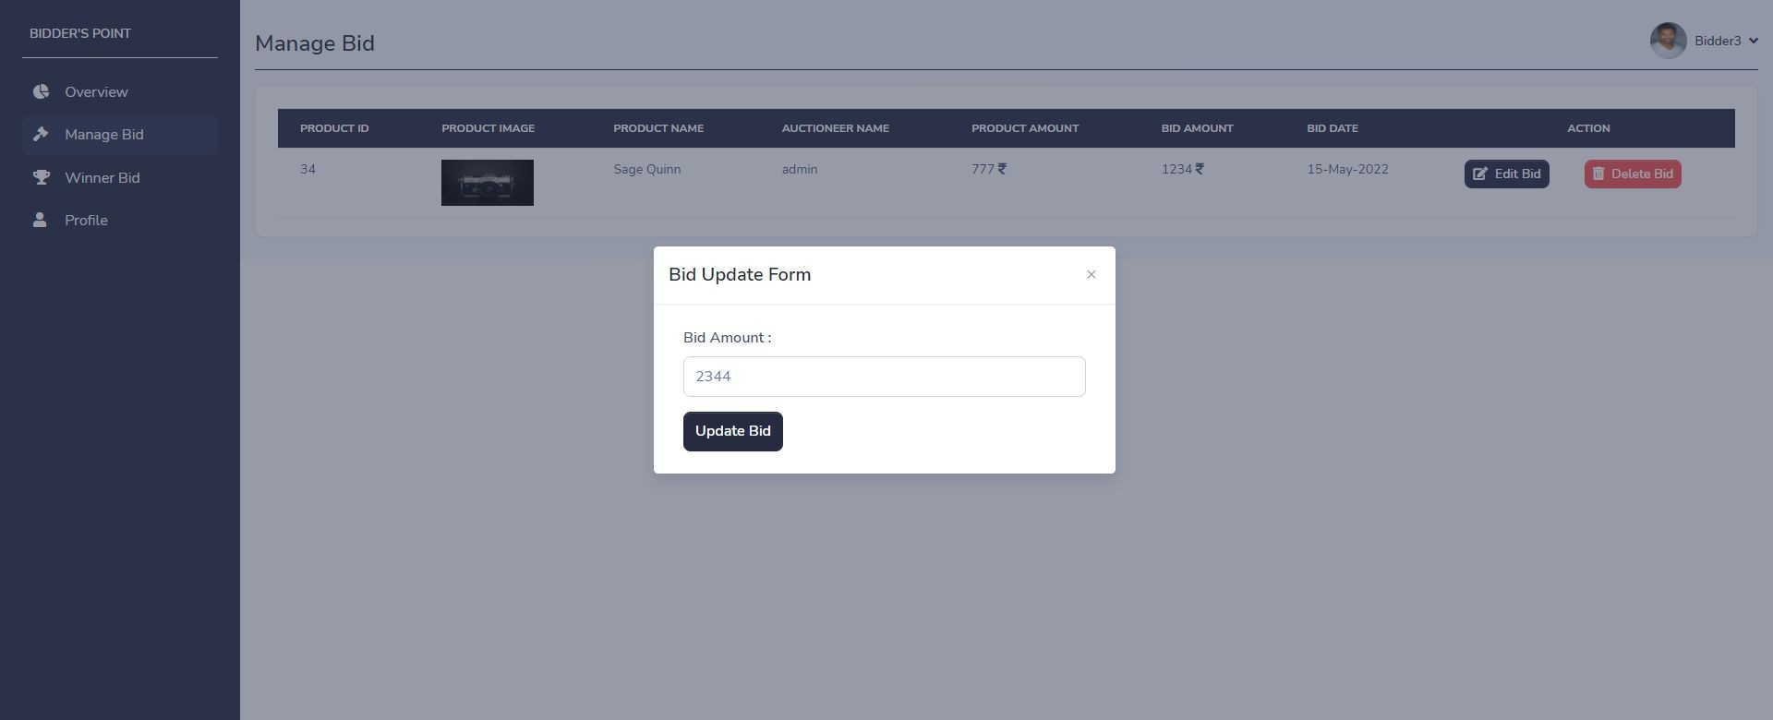
Edit bid page
Description: - It is edit bid page. Bidder can change bid by clicking on “edit bid” button on any particular bid.

Slide 74
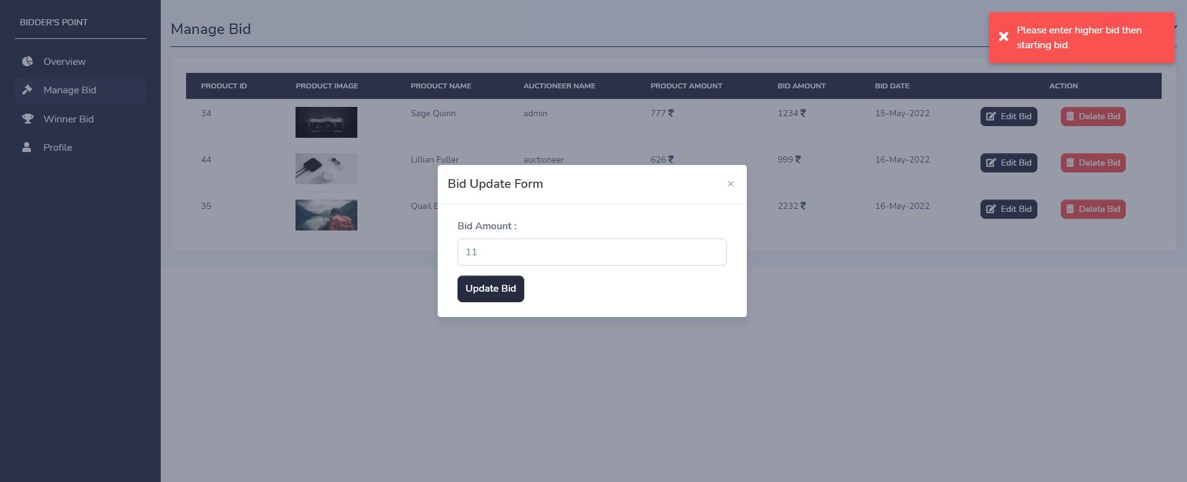
Edit bid page with validation
Description: - It is edit bid page with validation. If entered bid amount is less then product amount then edit bid page will give one error message as popup.

Slide 75
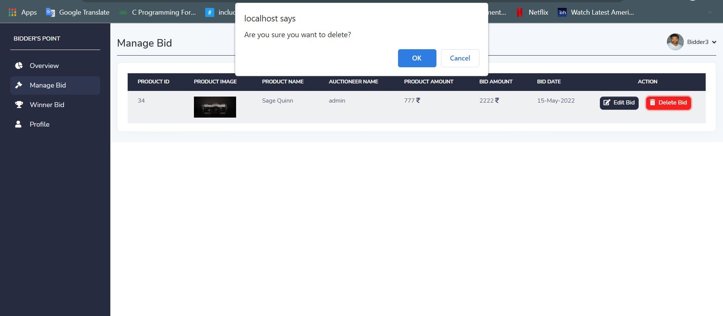
Delete bid with confirmation
Description: - It is delete bid functionality with confirmation message. Bidder can delete any bid by clicking on "delete" button.

Slide 76

Update profile page
Description: - It is update profile page. Bidder can update profile by clicking on “update profile” button.

Slide 77

Update profile page with validation
Description: - It is update profile page with validation. If image has invalid type or image is too big then page will give one error message as popup.

Slide 78

Forget password page
Description: - It is forgot password page. Bidder can forget password through this page. It will send link to email address where you can set your new password.

Slide 79

Forget password page with validation
Description: - It is forgot password page with validation. If the entered email is not found in database then forgot password page will give one error message as popup.

Slide 80
11. OUTPUT DESIGN

Slide 81
11.1 OUTPUT DESIGN FOR ADMIN SIDE

Slide 82

Admin Dashboard
Description: - This is admin dashboard, where admin gets direct link to the particular page and can see product , bid and winners from dashboard.

Slide 83

Product report
Description: - This is product report, where admin can see all the product and perform some operation like add , update and delete product.

Slide 84

Bid report
Description: - This is bid report, where admin can see all the bid and perform some operation like update and delete bid.

Slide 85

Check bid report
Description: - This is check bid report, where admin can see all the bid that have given on product and also accept bid and see information of bidder.

Slide 86

Winner report
Description: - This is winner report, where admin can see all the winners.

Slide 87

User report
Description: - This is users report, where admin can see all the users and perform some operation like add , update and delete users.

Slide 88
11.2 OUTPUT DESIGN FOR AUCTIONEER SIDE

Slide 89

Auctioneer Dashboard
Description: - This is auctioneer dashboard, where auctioneer gets direct link to the particular page and can see product, check bid and winners from dashboard.

Slide 90

Product report
Description: - This is product report, where auctioneer can see all the product and perform some operation like add , update and delete product.

Slide 91

Check bid report
Description: - This is check bid report, where auctioneer can see all bid that have given on product and also accept bid and see information of bidder.

Slide 92

Winner report
Description: - This is winner report, where auctioneer can see all the winners.

Slide 93
11.3 OUTPUT DESIGN FOR BIDDER SIDE

Slide 94

Bidder Dashboard
Description: - This is bidder dashboard, where bidder gets direct link to the particular page and can see bid and all winning product from dashboard.

Slide 95

Bid report
Description: - This is bid report, where bidder can see all bid and perform some operation like update and delete bid.

Slide 96

Won product report / Accepted bid report
Description: - This is won product report, where bidder can see all the won product.

Slide 97
12. TESTING
No. | Test Condition | Description | Expected Result | Actual Output | Status
1 | Registration | Click on sign up button without Username | System will display validation message | System display message like “All fields are required” | Pass
 |  | Click on sign up button without Email | System will display validation message | System display message like “All fields are required” | Pass
 |  | Click on sign up button with invalid mobile number | System will display validation message | System display message like “Enter valid phone number” | Pass
 |  | Click on sign up button with all valid input data | System will register a new user | System display message like “Registration successful” | Pass

Slide 98
No. | Test Condition | Description | Expected Result | Actual Output | Status
2 | Login | Non-Registered user | System will not allow Non-Registered user to login | System will display validation message like “Can’t find user” | Pass
 |  | Click on login button with invalid email and password | System will not allow user to login | System will display validation message like “Invalid login details” | Pass
 |  | Click on login button with valid email and password | System will allow to login | System will display validation message like “Login successful” | Pass

Slide 99
No. | Test Condition | Description | Expected Result | Actual Output | Status
3. | Forget Password | Click on reset password button without email | System will display validation message | System display message like “Email is required” | Pass
 |  | Click on reset password button with wrong email | System will display validation message | System display message like “Email doesn't exist!” | Pass
 |  | Click on reset password button with valid email | System will allow to send reset link to email | System display message like “Reset password link send to email” | Pass

Slide 100
No. | Test Condition | Description | Expected Result | Actual Output | Status
4. | Add Bid | Click on add bid button without bid amount and user is logged in as bidder. | System will display validation message | System display message like “Please enter your bid amount” | Pass
 |  | Click on add bid button without / with bid amount and user is not logged in as bidder | System will display validation message | System display message like “You have to be logged in as bidder to add bid” | Pass
 |  | Click on add bid button with bid amount and user is logged in as bidder | System will allow to add bid | System display message like “Bid added successfully” | Pass

Slide 101
No. | Test Condition | Description | Expected Result | Actual Output | Status
5. | Update Profile | Click on update button without email | System will display validation message | System display message like “All fields are required” | Pass
 |  | Click on update button without phone number | System will display validation message | System display message like “All fields are required” | Pass
 |  | Click on update button with invalid phone number | System will display validation message | System display message like “Enter valid phone number” | Pass
 |  | Click on update button with valid input data | System will allow to update profile | System display message like “User updated successfully” | Pass

Slide 102
13. FUTURE ENHANCEMENT
I will provide google authentication facility, so user can sign up through google account.
Notification system like how many auctioneer and bidder are active on website.
In future, I will provide the SMS and Email facility.
I will make SEO Friendly website.
I will provide ultimate and premium account facility so auctioneer and bidder will get more advantage.

Slide 103
14. BIBLIOGRAPHY
For developing this “ BIDDER’s POINT ” I have referred the following website:
CSS framework (Bootstrap)
https://getbootstrap.com/
Website template with dashboard design
https://themesberg.com/product/admin-dashboard/volt-bootstrap-5-dashboard
Icons
https://fontawesome.com/

Slide 104
THANK YOU

